Slide 1
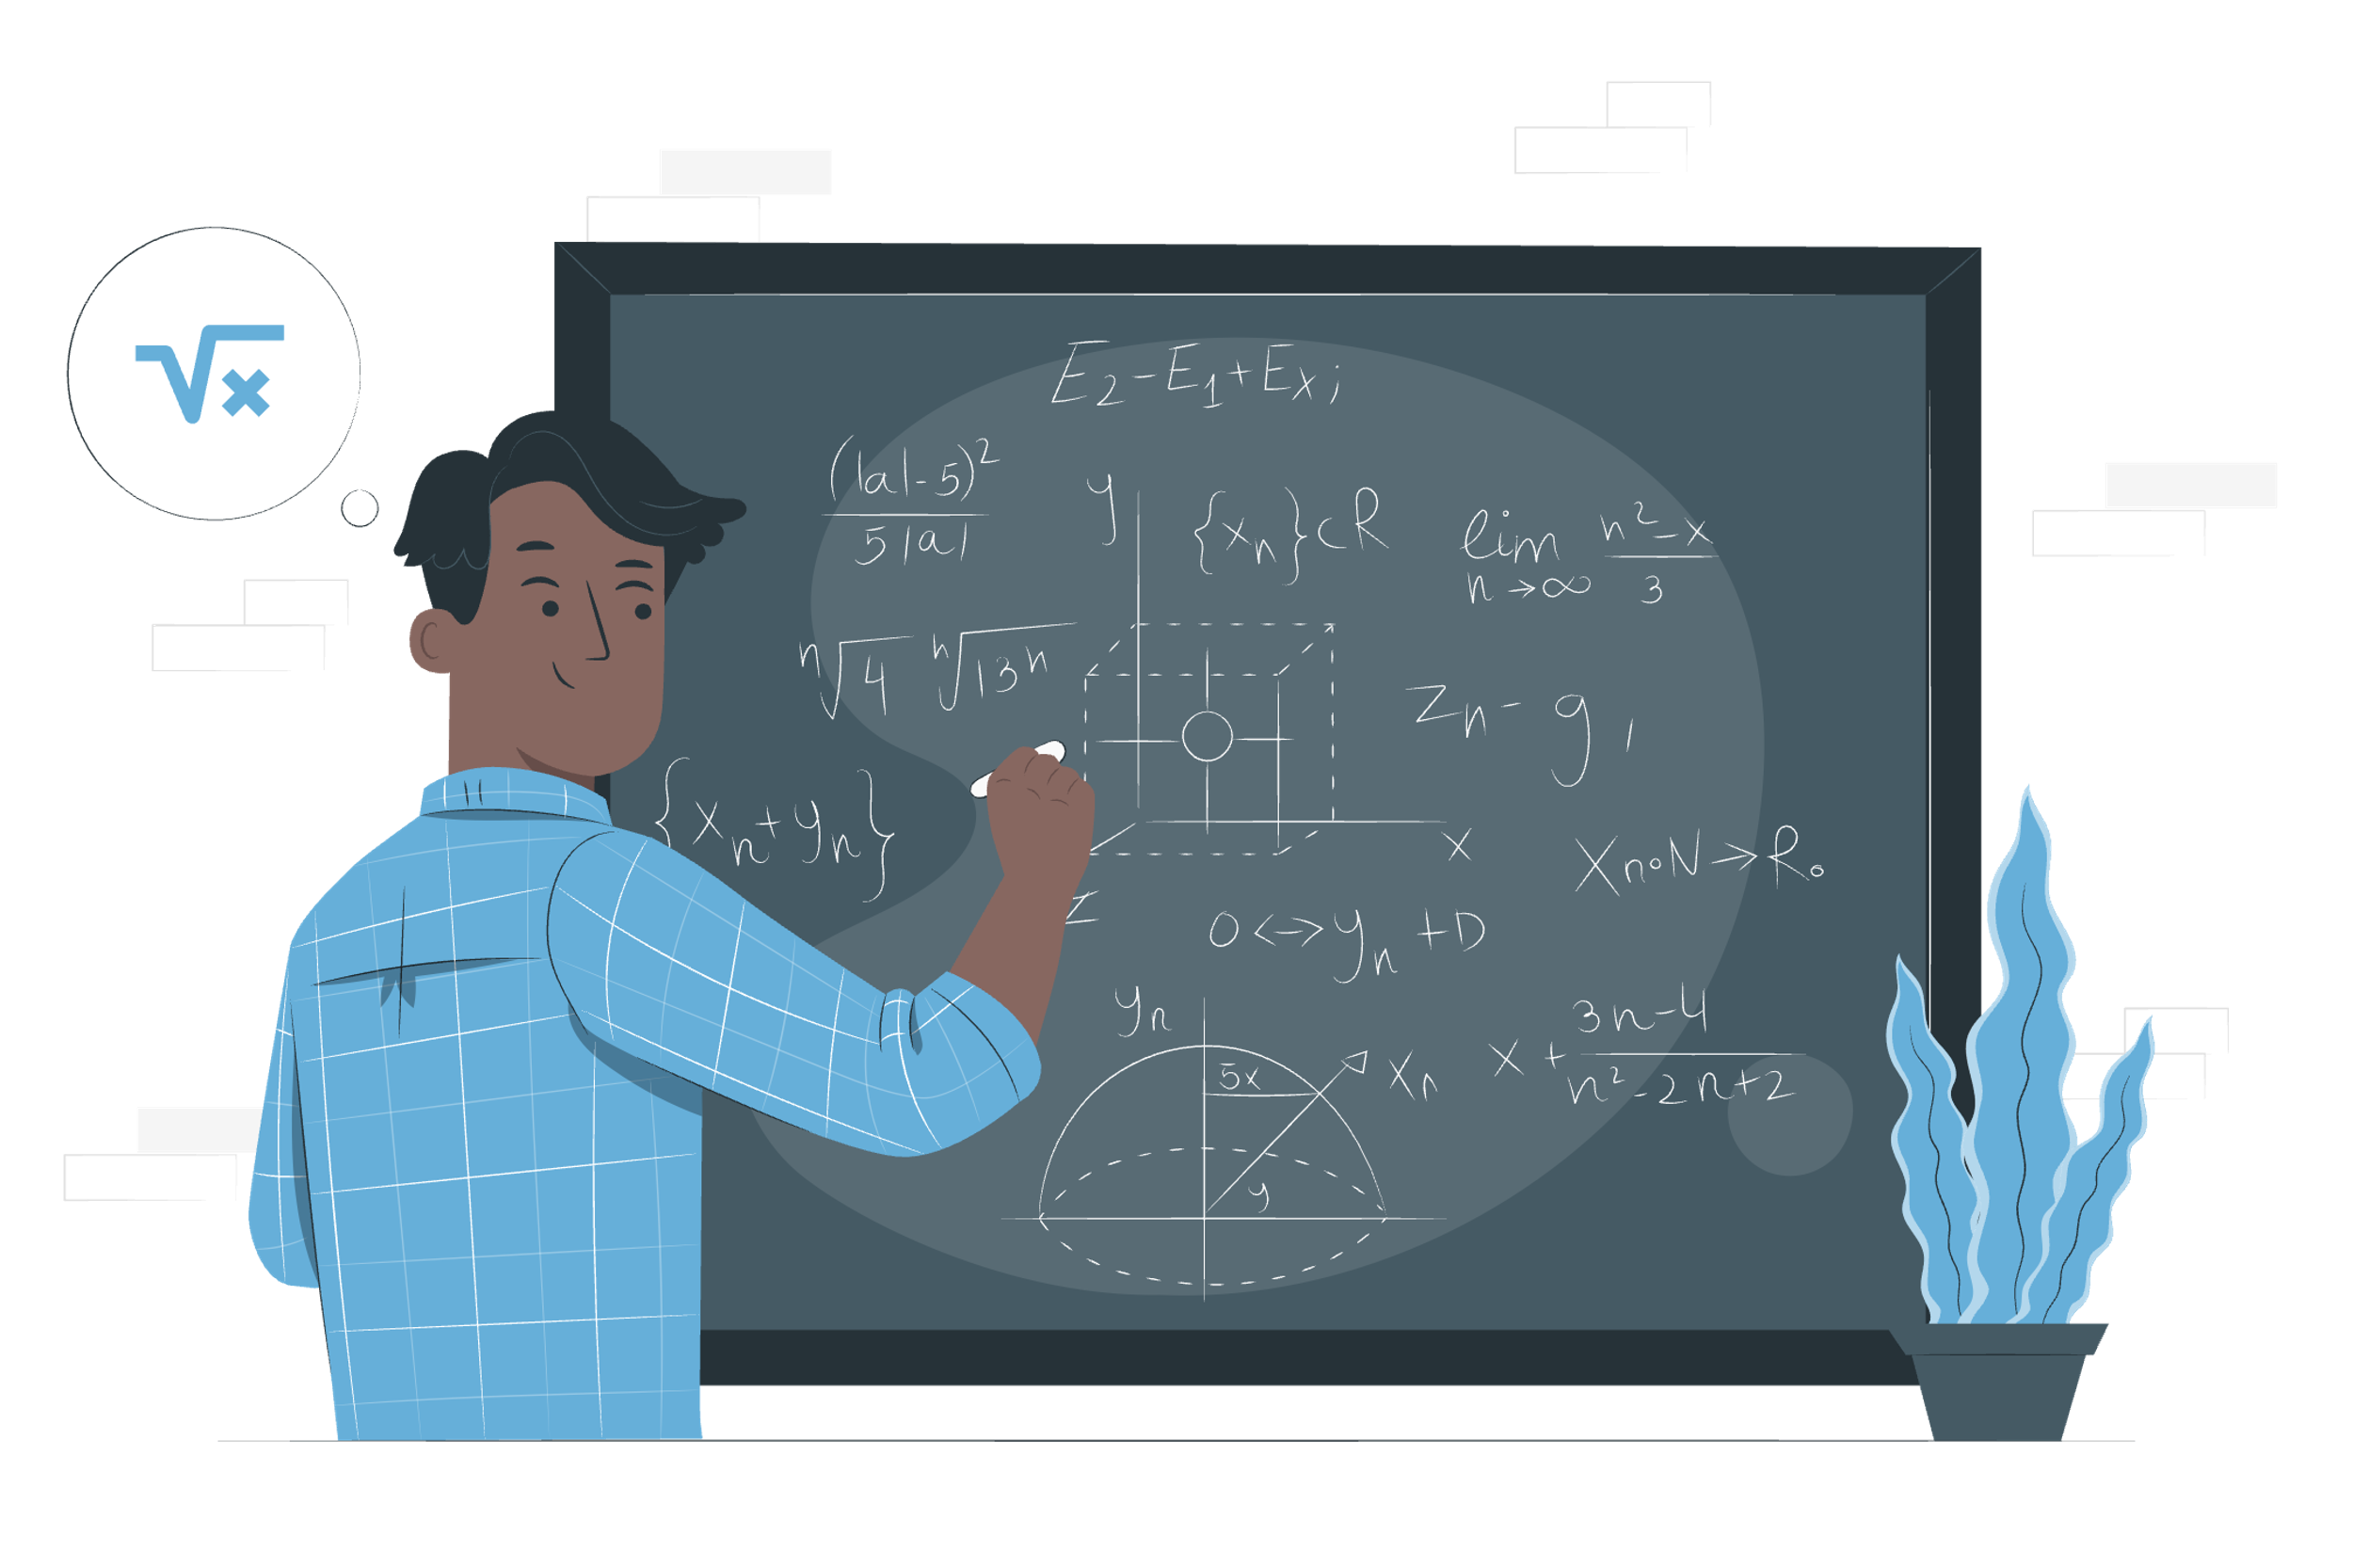
Discrete Math Chapter 1
Formal Logic

Slide 2
Chapter 1 Overview
1-1 Statements, Symbols, and Tautologies
1-2 Propositional Logic
1-3 Quantifiers and Predicates
1-4 Predicate Logic

Slide 3
Notes of Chapter 1
Chapter 8 is based on chapter 1, where we will learn boolean algebra and circuits design. Therefore, do not jump to chapter 8 before finishing chapter 1.
Programming is all about logic. Therefore, chapter 1 is the foundation of programming and computer science.

Slide 4

1-1 Statements, Symbols and Tautologies

Slide 5
Statement
A statement (or proposition) is a sentence that is either true or false.
For example:
“5 < 10” is a statement.
“Taipei is the capital city of Taiwan.” is a statement.
“There exist parallel universes.” is a statement. (We don’t necessarily need to know if it’s true or false.)
“He is the most talented piano player in the world.” is not a statement. (We don’t know who he is, so this sentence is neither true nor false.)

Slide 6
Truth Value and Logical Connective
The ”Truth Value” of a statement is either true or false. In daily conversation, we connect statements together to form more complex statements. The truth value of a compound statement depends on:
The statements that were connected together
The ”logical connective” that connects the statements
Statements are denoted in capital English letters, such as A, B, C, P, Q.
The following is a list of connectives in 1-1:
Conjunction
Disjunction
Implication
Equivalence

Slide 7
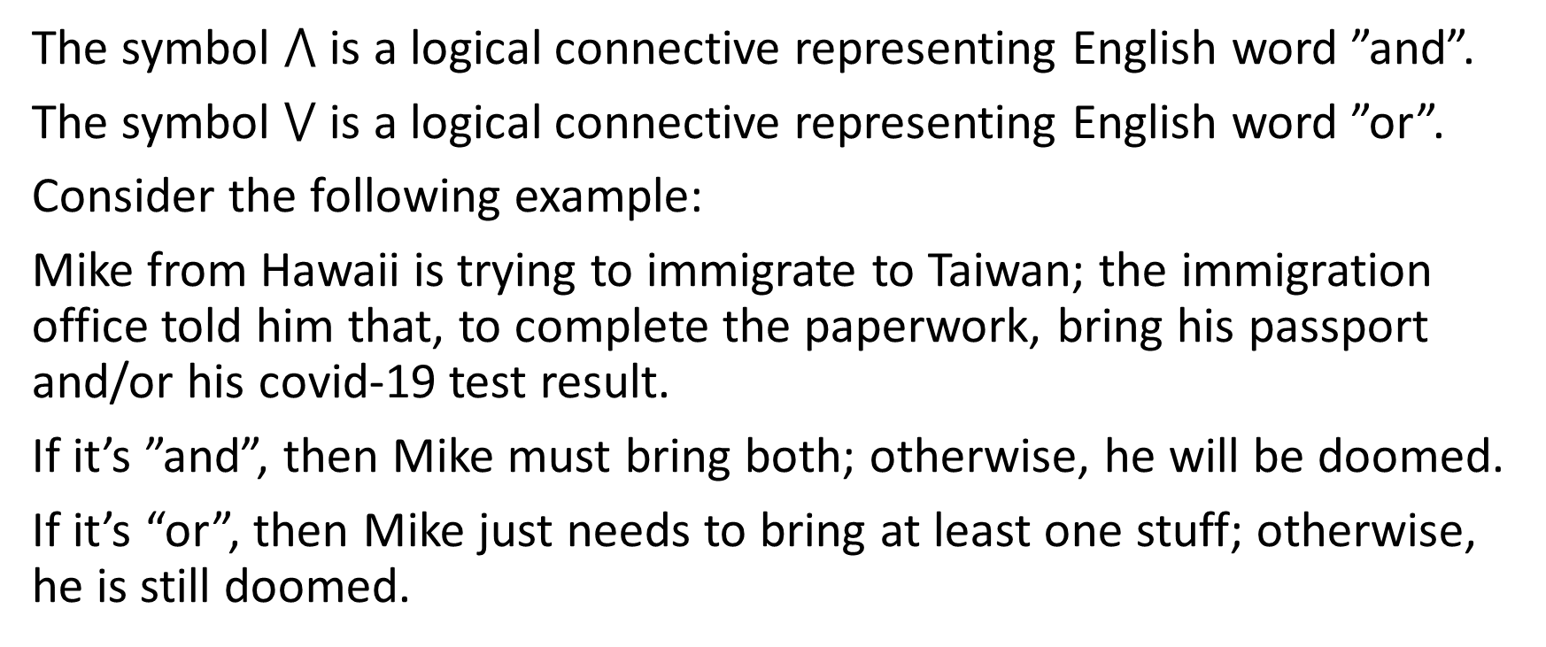
Conjunction and Disjunction Connective
The symbol $⋀$ is a logical connective representing English word ”and”.
The symbol $⋁$ is a logical connective representing English word ”or”.
Consider the following example:
Mike from Hawaii is trying to immigrate to Taiwan; the immigration office told him that, to complete the paperwork, bring his passport and/or his covid-19 test result.
If it’s ”and”, then Mike must bring both; otherwise, he will be doomed.
If it’s “or”, then Mike just needs to bring at least one stuff; otherwise, he is still doomed.

Slide 8
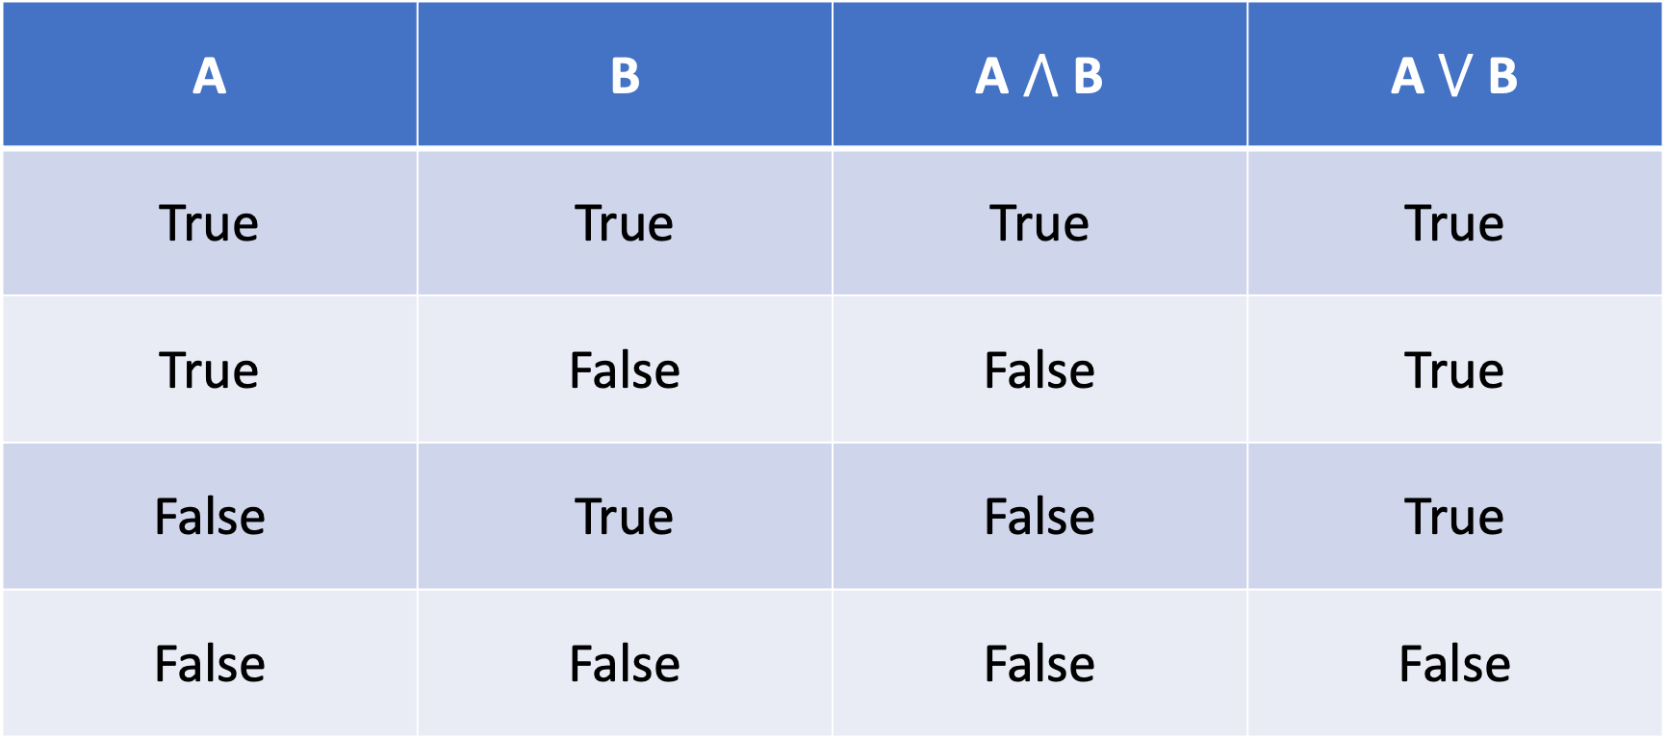
Truth Table of Conjunction and Disjunction
A | B | A $⋀$ B | A $⋁$ B
True | True | True | True
True | False | False | True
False | True | False | True
False | False | False | False

Slide 9
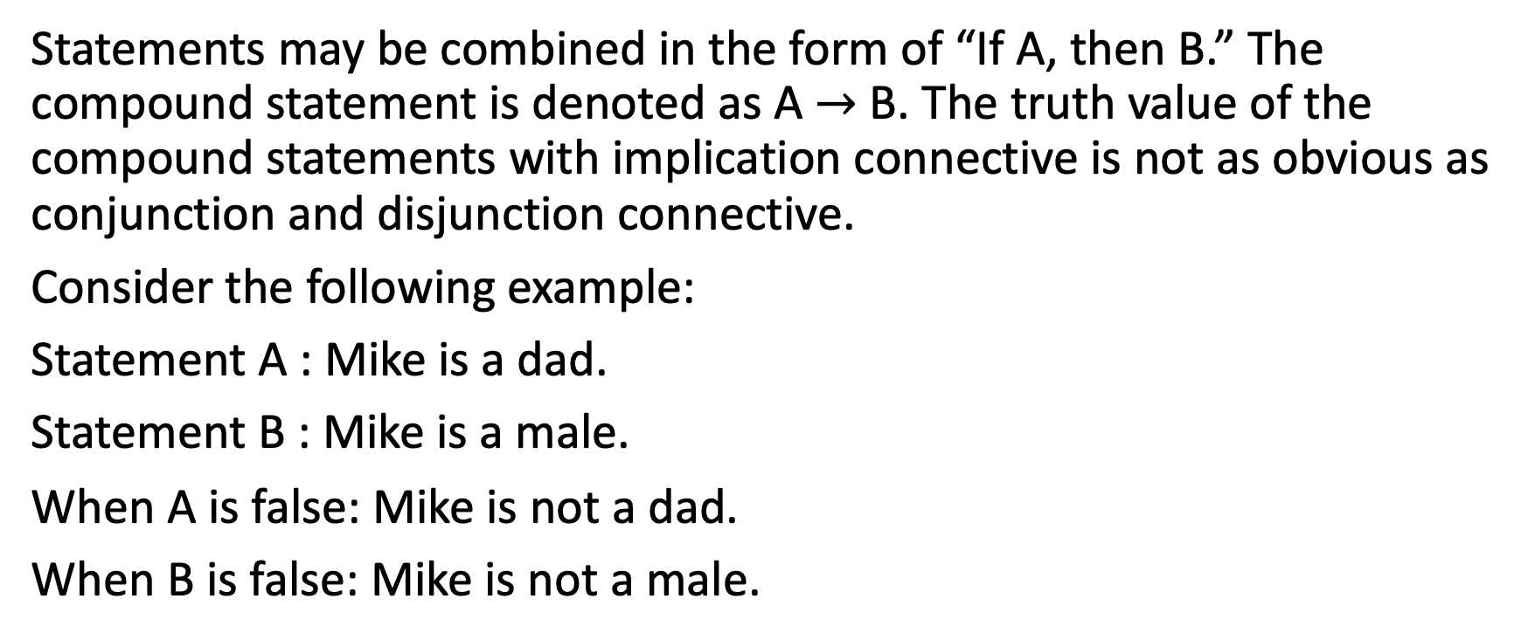
Implication Connective
Statements may be combined in the form of “If A, then B.” The compound statement is denoted as A $→$ B. The truth value of the compound statements with implication connective is not as obvious as conjunction and disjunction connective.
Consider the following example:
Statement A : Mike is a dad.
Statement B : Mike is a male.
When A is false: Mike is not a dad.
When B is false: Mike is not a male.

Slide 10
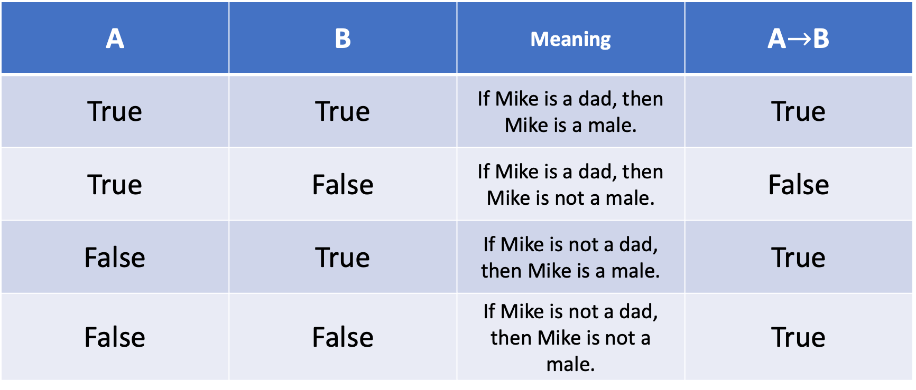
Truth Table of Implication Connective
A | B | Meaning | A$→$B
True | True | If Mike is a dad, then Mike is a male. | True
True | False | If Mike is a dad, then Mike is not a male. | False
False | True | If Mike is not a dad, then Mike is a male. | True
False | False | If Mike is not a dad, then Mike is not a male. | True
*. If the hypothesis is wrong, then no matter what the result is, the whole implication statement is right.
*. If the result is right, then no matter what the hypothesis is, the whole implication statement is right.

Slide 11
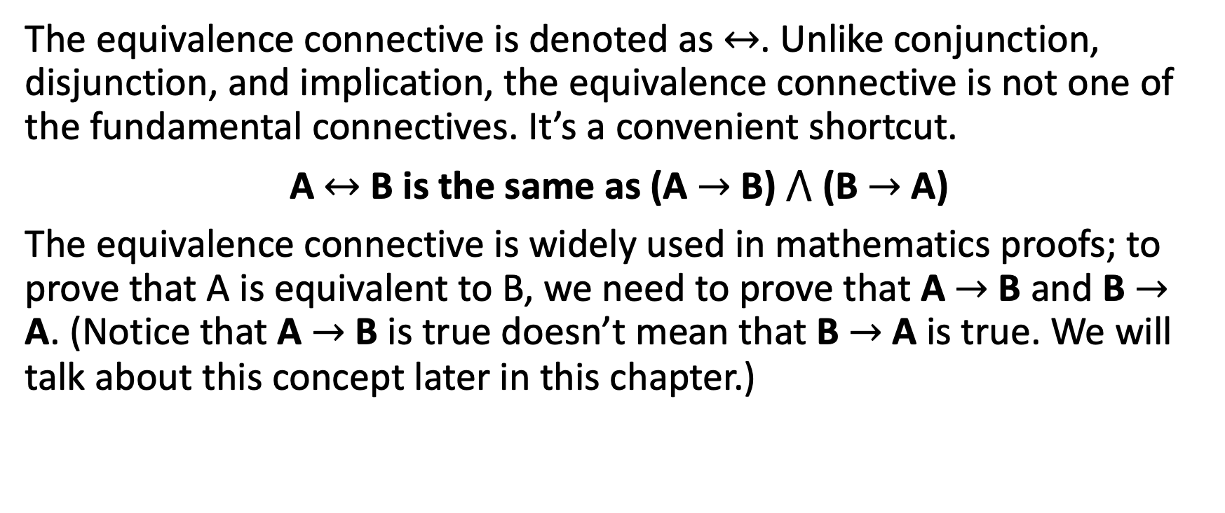
Equivalence Connective
The equivalence connective is denoted as $↔$. Unlike conjunction, disjunction, and implication, the equivalence connective is not one of the fundamental connectives. It’s a convenient shortcut.
A $↔$ B is the same as (A $→$ B) $⋀$ (B $→$ A)
The equivalence connective is widely used in mathematics proofs; to prove that A is equivalent to B, we need to prove that A $→$ B and B $→$ A. (Notice that A $→$ B is true doesn’t mean that B $→$ A is true. We will talk about this concept later in this chapter.)

Slide 12
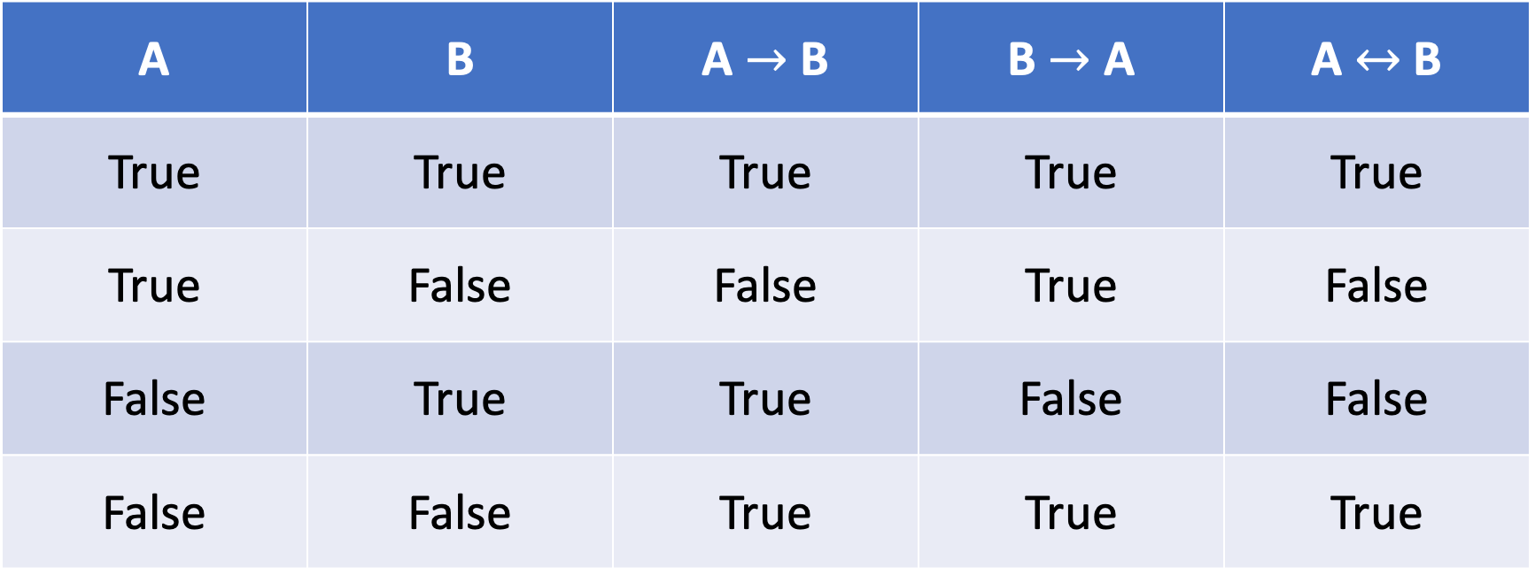
Truth Table of Equivalence Connective
A | B | A $→$ B | B $→$ A | A $↔$ B
True | True | True | True | True
True | False | False | True | False
False | True | True | False | False
False | False | True | True | True
*. Only when A and B have the same truth value would the compound statement A $↔$ B become true. Therefore, if A is equivalent to B, that means that A must have the same truth value as B.

Slide 13
Negation
The connectives we’ve discussed so far are all binary connectives, as they join two statements together and produce a compound statement. Let’s consider this unary connective – Negation.
Negation produces the oppositive truth value of a statement. Negation is denoted with a prime(‘).
For example:
A: Adam is 200cm tall.
A’: Adam is not 200cm tall.
B: Mike is a male.
B’: Mike is not a male.

Slide 14
Negation in Compound Statements
It’s really simple to negate a simple statement. Let’s now discuss how to negate a compound statement.
De Morgan’s Laws (Negation of Conjunction and Disjunction)
Implication’s Negation
Equivalence Negation (Very simple)

Slide 15
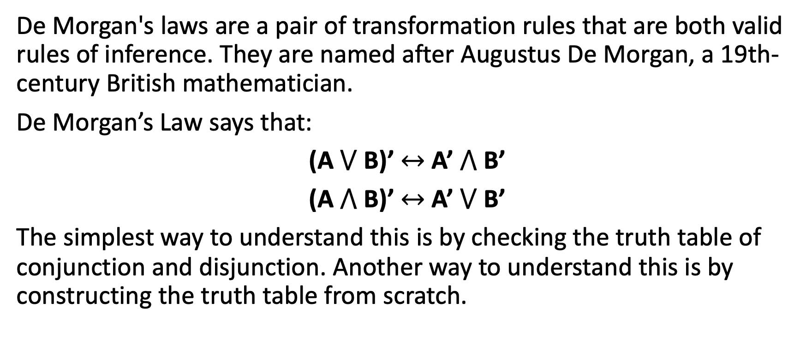
De Morgan’s Laws
De Morgan's laws are a pair of transformation rules that are both valid rules of inference. They are named after Augustus De Morgan, a 19th-century British mathematician.
De Morgan’s Law says that:
(A $⋁$ B)’ $↔$ A’ $⋀$ B’
(A $⋀$ B)’ $↔$ A’ $⋁$ B’
The simplest way to understand this is by checking the truth table of conjunction and disjunction. Another way to understand this is by constructing the truth table from scratch.

Slide 16
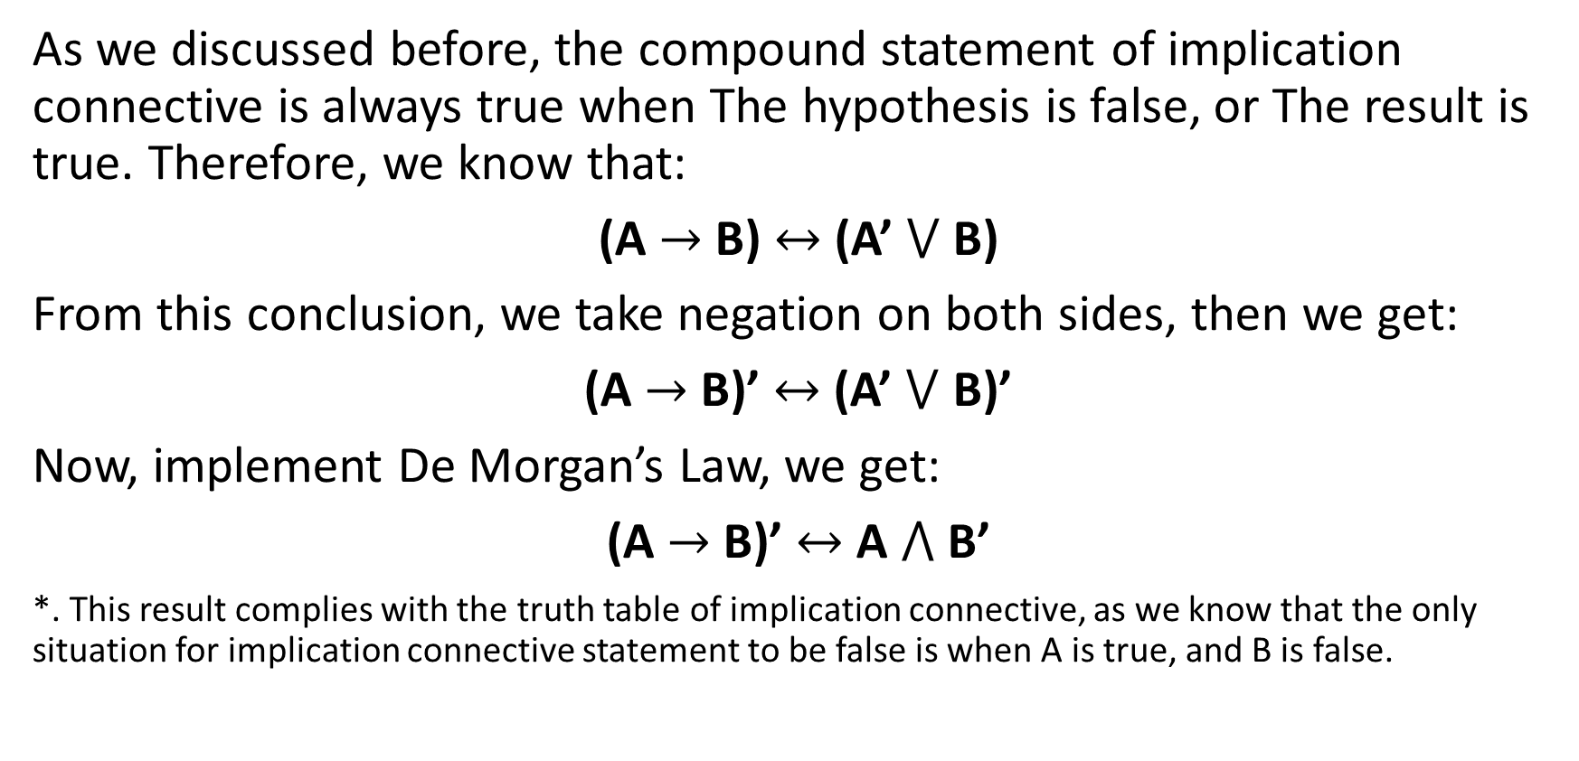
Negation of Implication Connective
As we discussed before, the compound statement of implication connective is always true when The hypothesis is false, or The result is true. Therefore, we know that:
(A $→$ B) $↔$ (A’ $⋁$ B)
From this conclusion, we take negation on both sides, then we get:
(A $→$ B)’ $↔$ (A’ $⋁$ B)’
Now, implement De Morgan’s Law, we get:
(A $→$ B)’ $↔$ A $⋀$ B’
*. This result complies with the truth table of implication connective, as we know that the only situation for implication connective statement to be false is when A is true, and B is false.

Slide 17
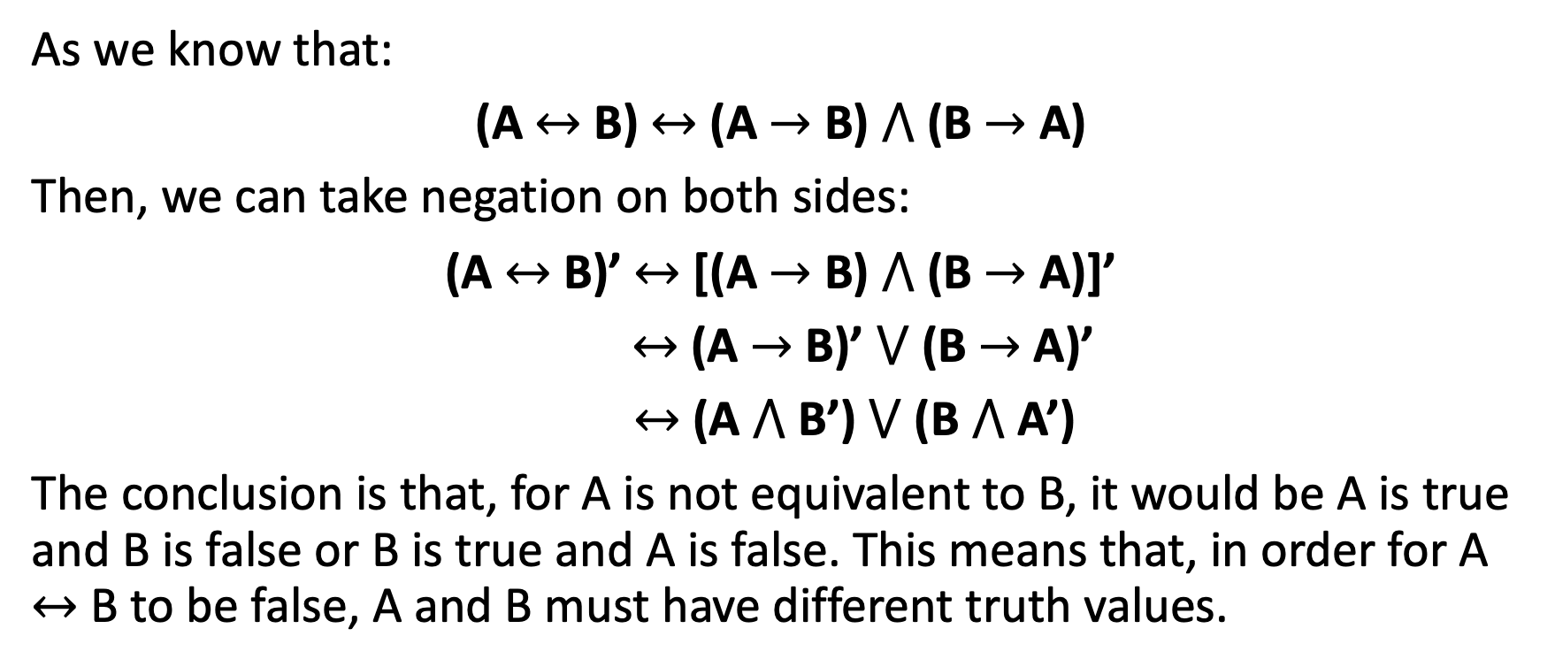
Negation of Equivalence Connective
As we know that:
(A $↔$ B) $↔$ (A $→$ B) $⋀$ (B $→$ A)
Then, we can take negation on both sides:
(A $↔$ B)’ $↔$ [(A $→$ B) $⋀$ (B $→$ A)]’
$↔$ (A $→$ B)’ $⋁$ (B $→$ A)’
$↔$ (A $⋀$ B’) $⋁$ (B $⋀$ A’)
The conclusion is that, for A is not equivalent to B, it would be A is true and B is false or B is true and A is false. This means that, in order for A $↔$ B to be false, A and B must have different truth values.

Slide 18
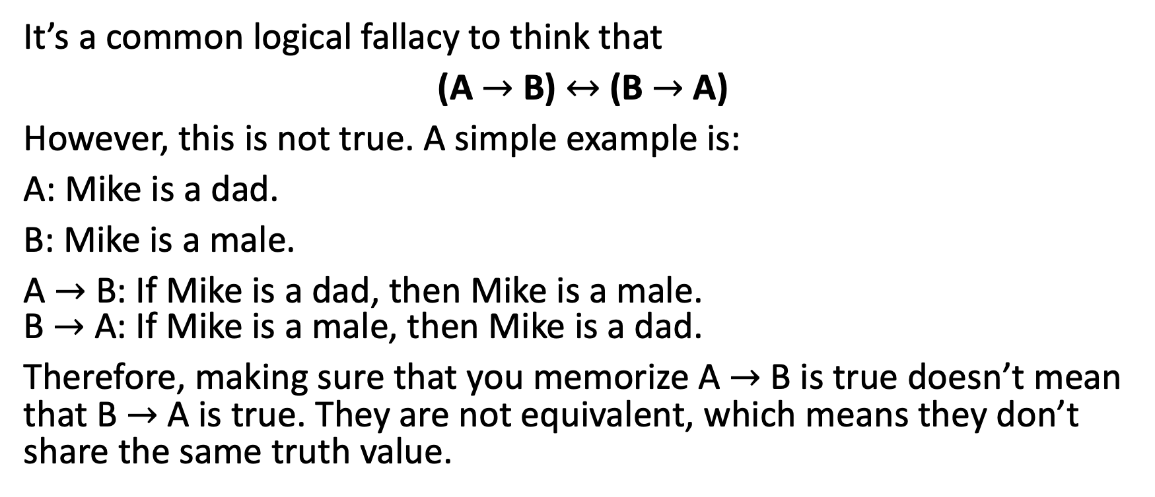
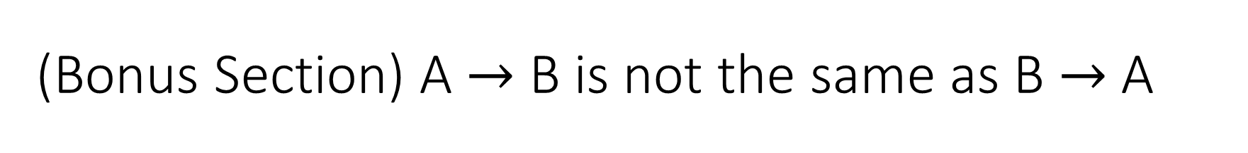
(Bonus Section) A $→$ B is not the same as B $→$ A
It’s a common logical fallacy to think that
(A $→$ B) $↔$ (B $→$ A)
However, this is not true. A simple example is:
A: Mike is a dad.
B: Mike is a male.
A $→$ B: If Mike is a dad, then Mike is a male. B $→$ A: If Mike is a male, then Mike is a dad.
Therefore, making sure that you memorize A $→$ B is true doesn’t mean that B $→$ A is true. They are not equivalent, which means they don’t share the same truth value.

Slide 19
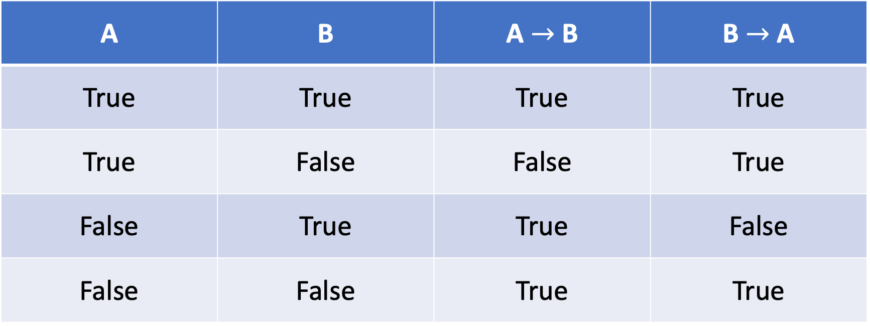

Truth Table of A $→$ B and B $→$ A.
A | B | A $→$ B | B $→$ A
True | True | True | True
True | False | False | True
False | True | True | False
False | False | True | True
*. This is another way to see that A $→$ B is not the same as B $→$ A.

Slide 20
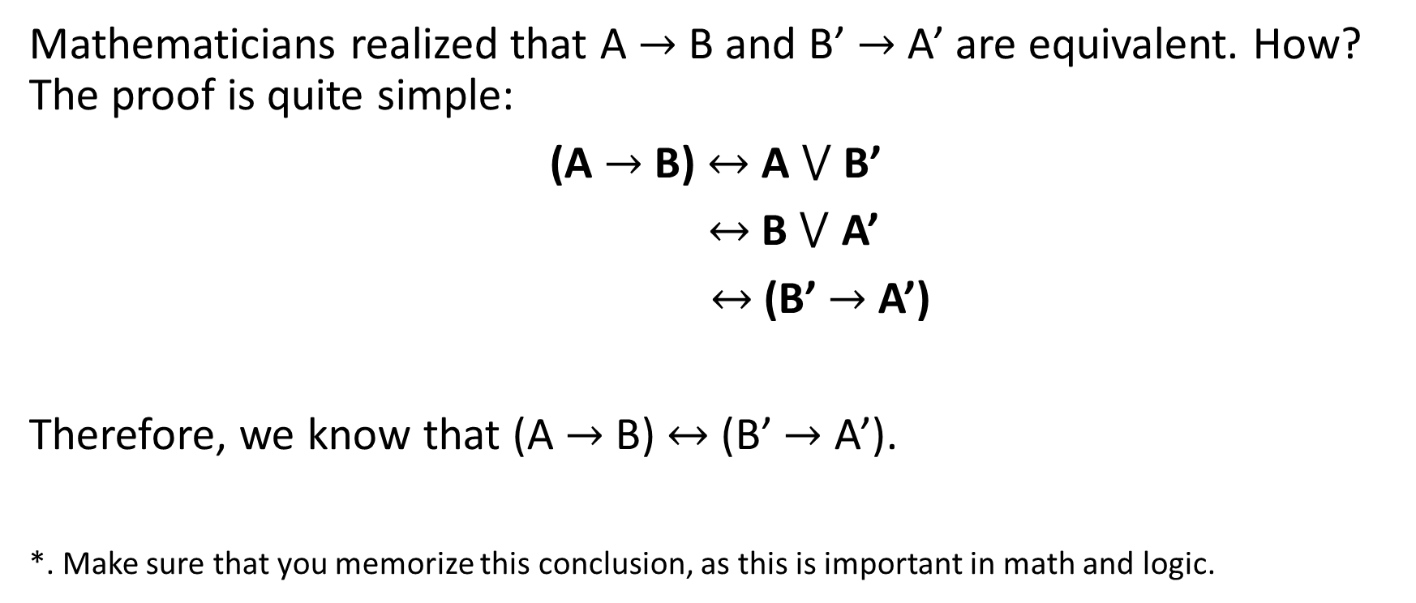
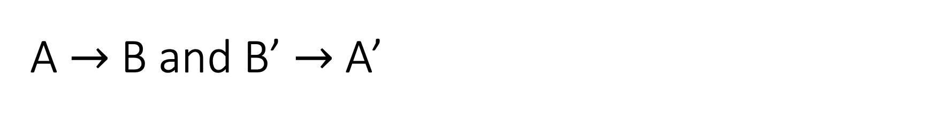
A $→$ B and B’ $→$ A’
Mathematicians realized that A $→$ B and B’ $→$ A’ are equivalent. How? The proof is quite simple:
(A $→$ B) $↔$ A $⋁$ B’
$↔$ B $⋁$ A’
$↔$ (B’ $→$ A’)
Therefore, we know that (A $→$ B) $↔$ (B’ $→$ A’).
*. Make sure that you memorize this conclusion, as this is important in math and logic.

Slide 21
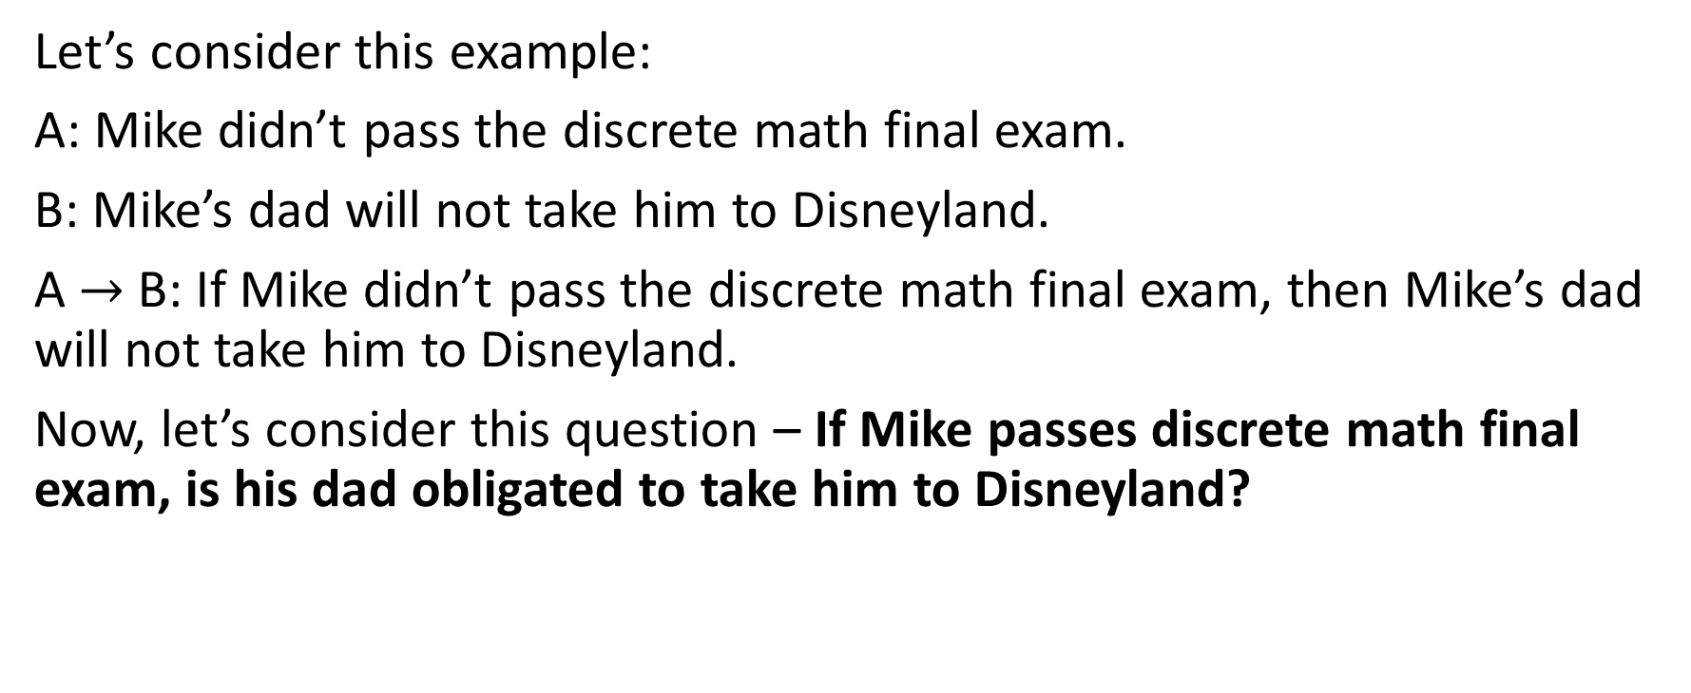
Implication Connective Application
Let’s consider this example:
A: Mike didn’t pass the discrete math final exam.
B: Mike’s dad will not take him to Disneyland.
A $→$ B: If Mike didn’t pass the discrete math final exam, then Mike’s dad will not take him to Disneyland.
Now, let’s consider this question – If Mike passes discrete math final exam, is his dad obligated to take him to Disneyland?

Slide 22
Answer
The answer is no. Mike’s dad is not obligated to take Mike to Disneyland. Why?
If Mike passes discrete math final, that means A is false. If A is false, then no matter what B is true or not, the whole compound statement is still true. That’s why Mike’s dad is not obligated to bring Mike to Disneyland. (This is a skillful way to make contracts.)
Notice the difference in making statements. If we set:
A: Mike passes the discrete math final exam.
B: Mike’s dad will take him to Disneyland.
That would result in, if Mike passes discrete math final exam, then Mike’s dad must take him to Disneyland. Mike’s dad is on obligation.

Slide 23
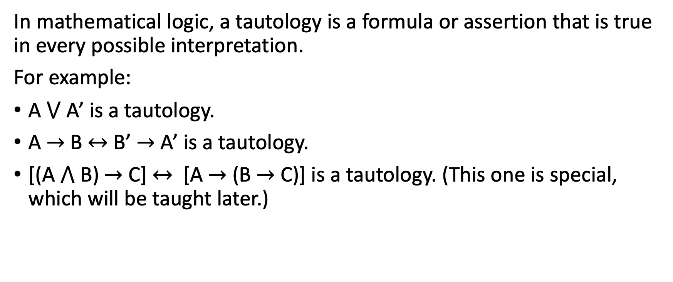
Tautologies
In mathematical logic, a tautology is a formula or assertion that is true in every possible interpretation.
For example:
A $⋁$ A’ is a tautology.
A $→$ B $↔$ B’ $→$ A’ is a tautology.
[(A $⋀$ B) $→$ C] $↔$ [A $→$ (B $→$ C)] is a tautology. (This one is special, which will be taught later.)

Slide 24
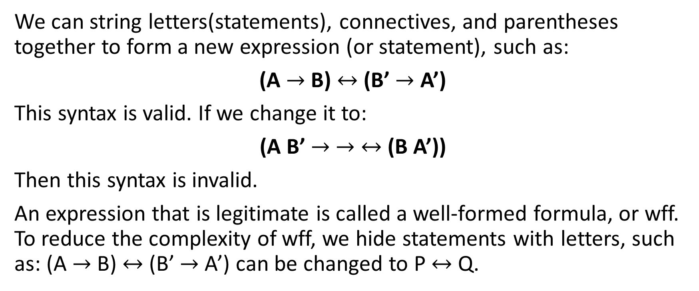
Well-Formed Formula (wff)
We can string letters(statements), connectives, and parentheses together to form a new expression (or statement), such as:
(A $→$ B) $↔$ (B’ $→$ A’)
This syntax is valid. If we change it to:
(A B’ $→$ $→$ $↔$ (B A’))
Then this syntax is invalid.
An expression that is legitimate is called a well-formed formula, or wff. To reduce the complexity of wff, we hide statements with letters, such as: (A $→$ B) $↔$ (B’ $→$ A’) can be changed to P $↔$ Q.

Slide 25
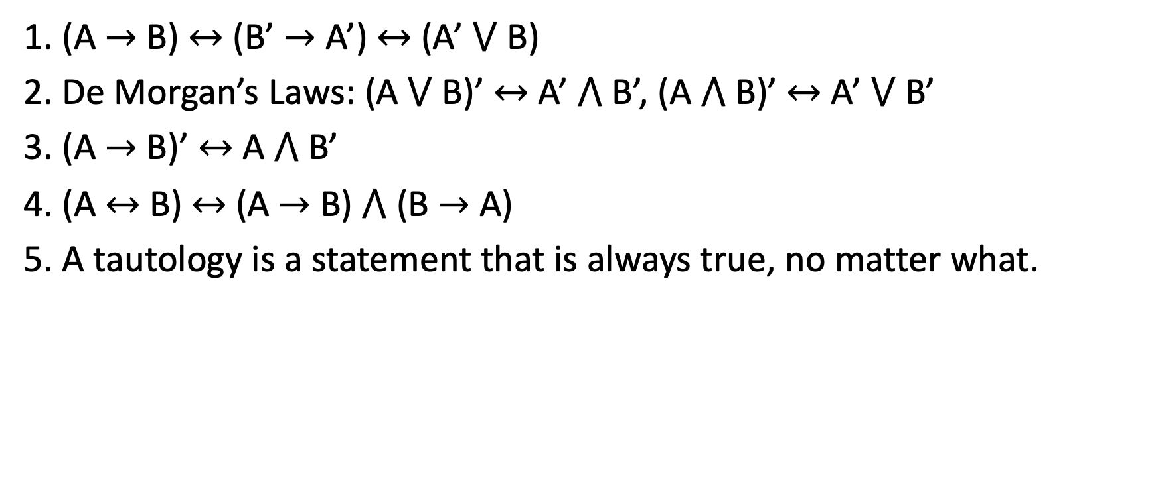
Chapter 1-1 Review
1. (A $→$ B) $↔$ (B’ $→$ A’) $↔$ (A’ $⋁$ B)
2. De Morgan’s Laws: (A $⋁$ B)’ $↔$ A’ $⋀$ B’, (A $⋀$ B)’ $↔$ A’ $⋁$ B’
3. (A $→$ B)’ $↔$ A $⋀$ B’
4. (A $↔$ B) $↔$ (A $→$ B) $⋀$ (B $→$ A)
5. A tautology is a statement that is always true, no matter what.

Slide 26

1-2 Propositional Logic

Slide 27
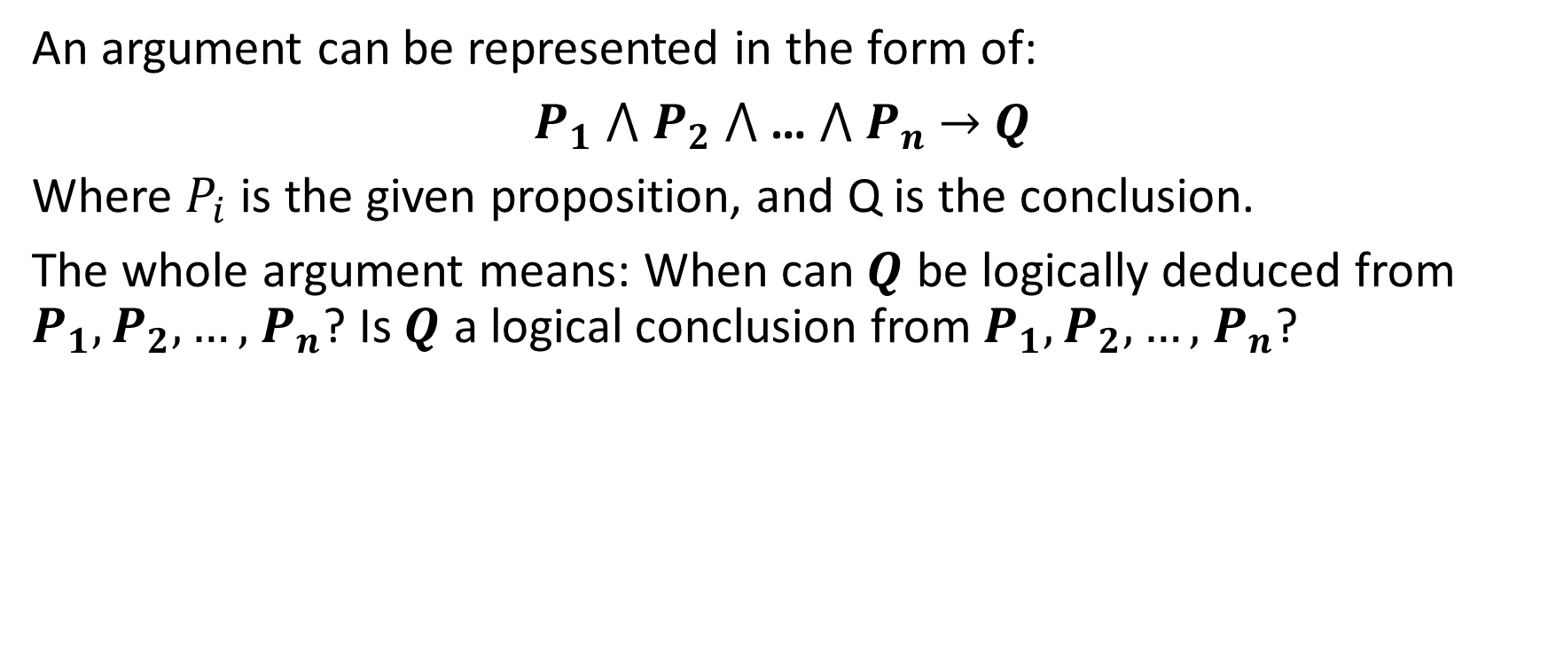
Valid Argument
An argument can be represented in the form of:
$P_{1}$ $⋀$ $P_{2}$ $⋀$ … $⋀ P_{n}$ $→$ $Q$
Where $P_{i}$ is the given proposition, and Q is the conclusion.
The whole argument means: When can $Q$ be logically deduced from $P_{1}, P_{2}, …,$ $P_{n}$? Is $Q$ a logical conclusion from $P_{1}, P_{2}, …,$ $P_{n}$?

Slide 28
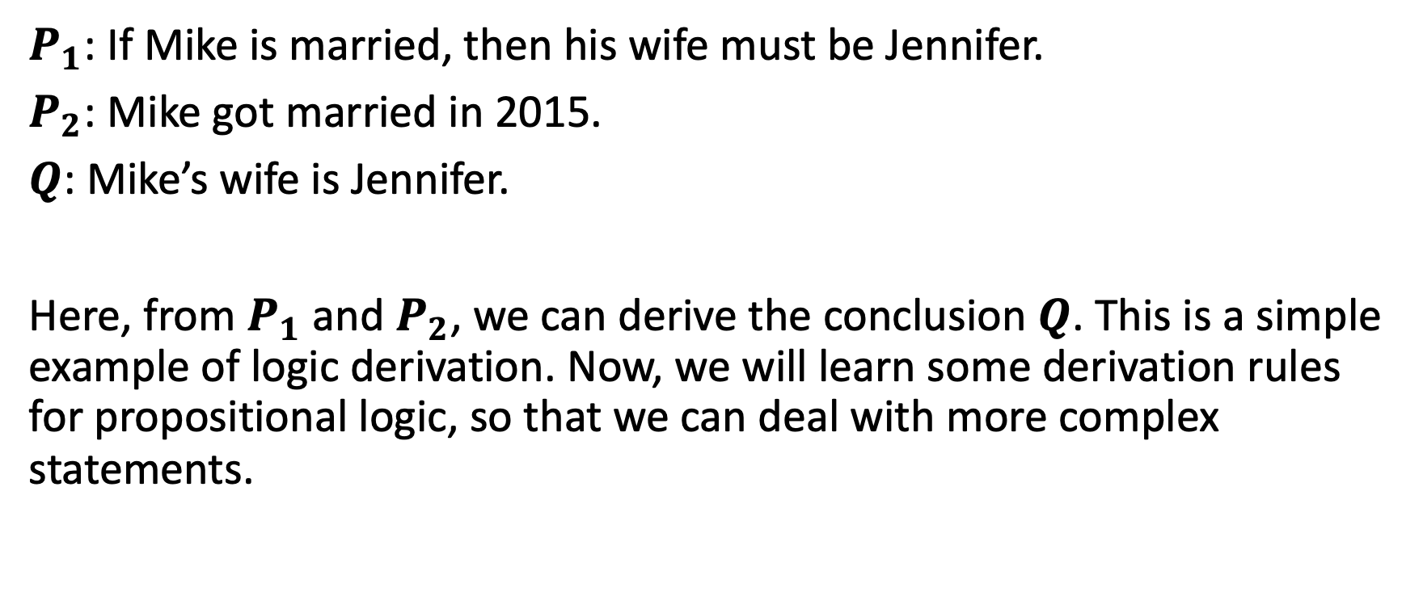
Example of Valid Argument
$P_{1}$: If Mike is married, then his wife must be Jennifer.
$P_{2}$: Mike got married in 2015.
$Q$: Mike’s wife is Jennifer.
Here, from $P_{1}$ and $P_{2}$, we can derive the conclusion $Q$. This is a simple example of logic derivation. Now, we will learn some derivation rules for propositional logic, so that we can deal with more complex statements.

Slide 29
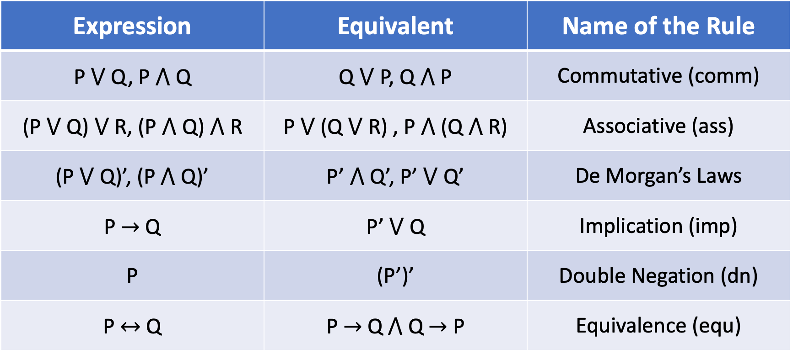
Derivation Rules for Propositional Logic
Expression | Equivalent | Name of the Rule
P $⋁$ Q, P $⋀$ Q | Q $⋁$ P, Q $⋀$ P | Commutative (comm)
(P $⋁$ Q) $⋁$ R, (P $⋀$ Q)$⋀$ R | P $⋁$ (Q $⋁$ R) , P $⋀$ (Q$⋀$ R) | Associative (ass)
(P $⋁$ Q)’, (P$⋀$ Q)’ | P’ $⋀$ Q’, P’ $⋁$ Q’ | De Morgan’s Laws
P $→$ Q | P’ $⋁$ Q | Implication (imp)
P | (P’)’ | Double Negation (dn)
P $↔$ Q | P$→$ Q $⋀$ Q$→$ P | Equivalence (equ)

Slide 30
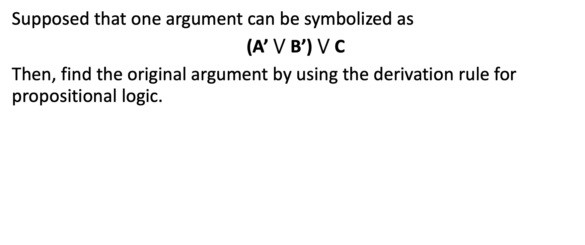
Example 1-2-1
Supposed that one argument can be symbolized as
(A’ $⋁$ B’) $⋁$ C
Then, find the original argument by using the derivation rule for propositional logic.

Slide 31
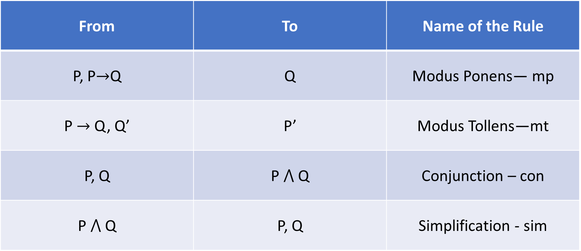
Derivation Rules for Propositional Logic
From | To | Name of the Rule
P, P$→$Q | Q | Modus Ponens— mp
P$→$ Q, Q’ | P’ | Modus Tollens—mt
P, Q | P$⋀$ Q | Conjunction – con
P$⋀$ Q | P, Q | Simplification - sim
*. This is a one-way rule. We cannot reverse the derivation rules in this table.

Slide 32
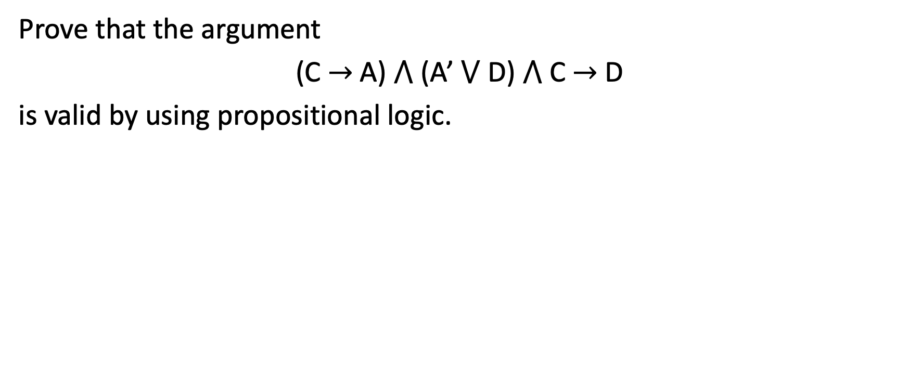
Example 1-2-2
Prove that the argument
(C $→$A) $⋀$ (A’ $⋁$ D)$⋀$ C $→$D
is valid by using propositional logic.

Slide 33
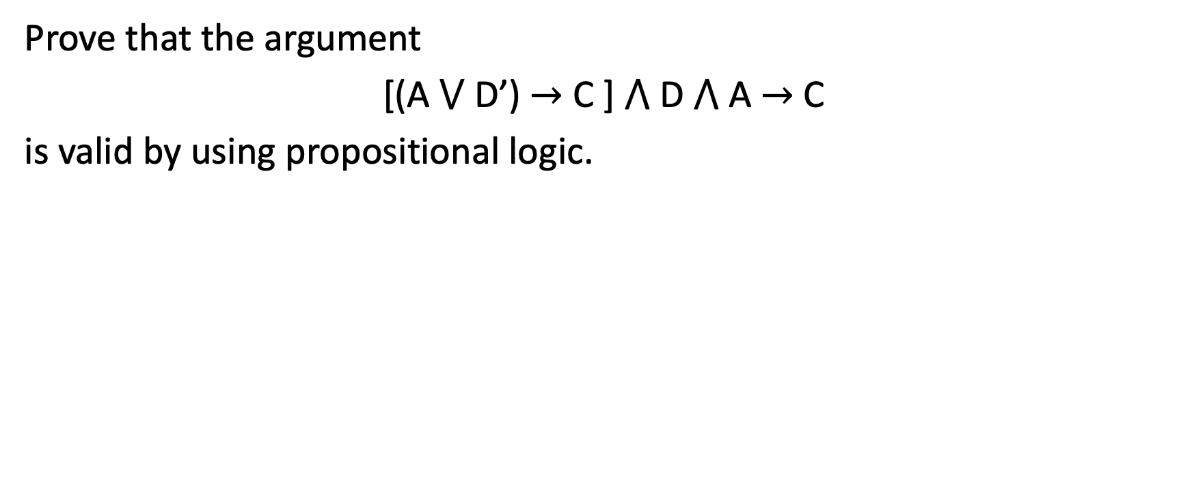
Example 1-2-3
Prove that the argument
[(A$⋁$ D’) $→$ C ]$⋀$ D$⋀$ A $→$ C
is valid by using propositional logic.

Slide 34
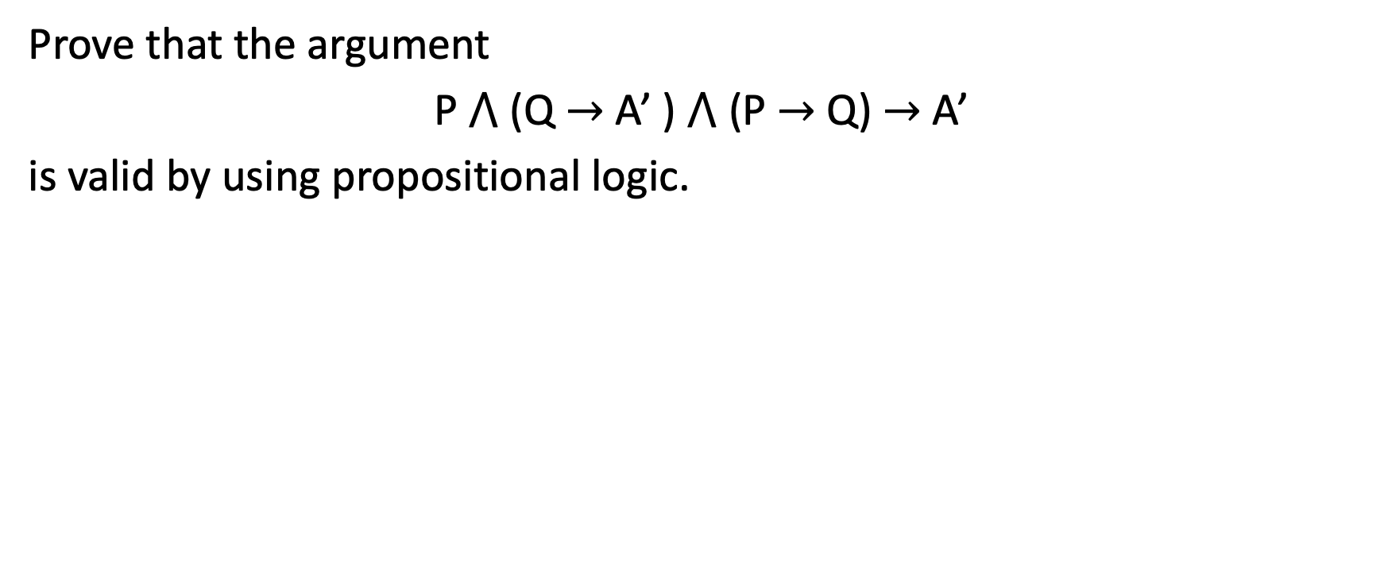
Example 1-2-4
Prove that the argument
P $⋀$ (Q $→$ A’ ) $⋀$ (P $→$ Q) $→$ A’
is valid by using propositional logic.

Slide 35
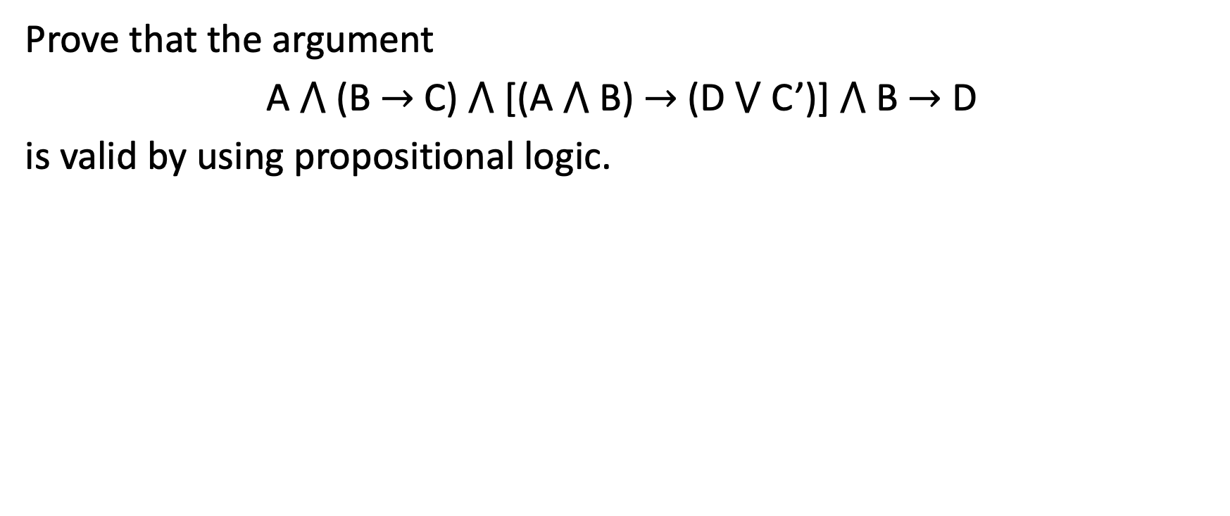
Example 1-2-5
Prove that the argument
A $⋀$ (B $→$ C) $⋀$ [(A $⋀$ B) $→$ (D $⋁$ C’)] $⋀$ B $→$ D
is valid by using propositional logic.

Slide 36
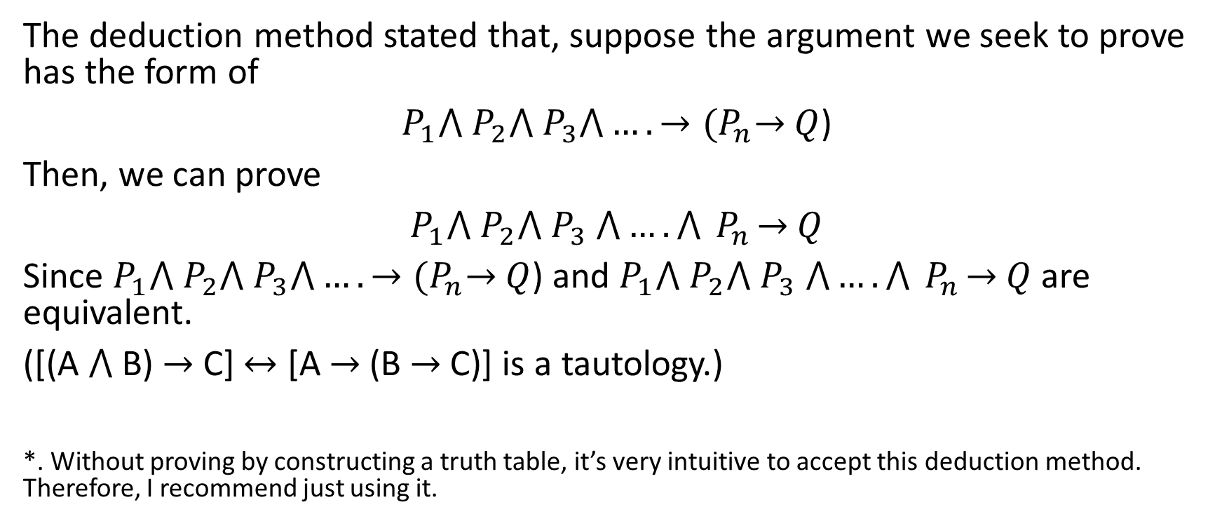
Deduction Method
The deduction method stated that, suppose the argument we seek to prove has the form of
$P_{1}⋀{ P}_{2}⋀{ P}_{3}⋀….→{(P}_{n}→$ $Q$)
Then, we can prove
$P_{1}⋀{ P}_{2}⋀{ P}_{3} ⋀….⋀{ P}_{n}→$ $Q$
Since $P_{1}⋀{ P}_{2}⋀{ P}_{3}⋀….→{(P}_{n}→$ $Q$) and $P_{1}⋀{ P}_{2}⋀{ P}_{3} ⋀….⋀{ P}_{n}→$ $Q$ are equivalent.
([(A $⋀$ B) $→$ C] $↔$ [A $→$ (B $→$ C)] is a tautology.)
*. Without proving by constructing a truth table, it’s very intuitive to accept this deduction method. Therefore, I recommend just using it.

Slide 37
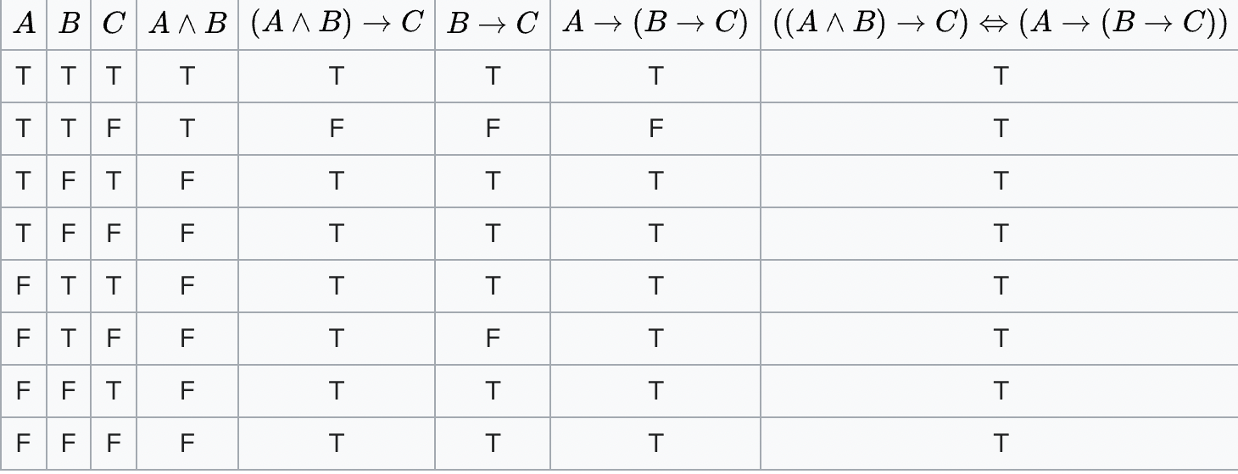
From Wikipedia, proof of deduction method
*. Even though this is only with A, B, and C 3 statements, the same concept applies to any number of statements. This can be proved by using recursion (which is not yet taught in discrete math.)

Slide 38
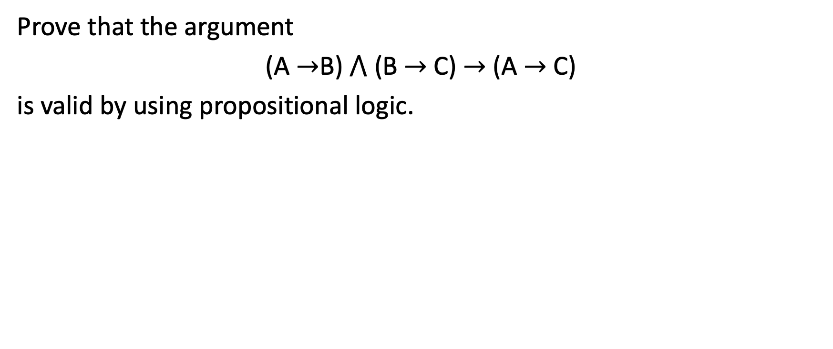
Example 1-2-6
Prove that the argument
(A $→$B)$⋀$ (B $→$C) $→$ (A $→$ C)
is valid by using propositional logic.

Slide 39

1-3 Quantifiers and Predicates

Slide 40
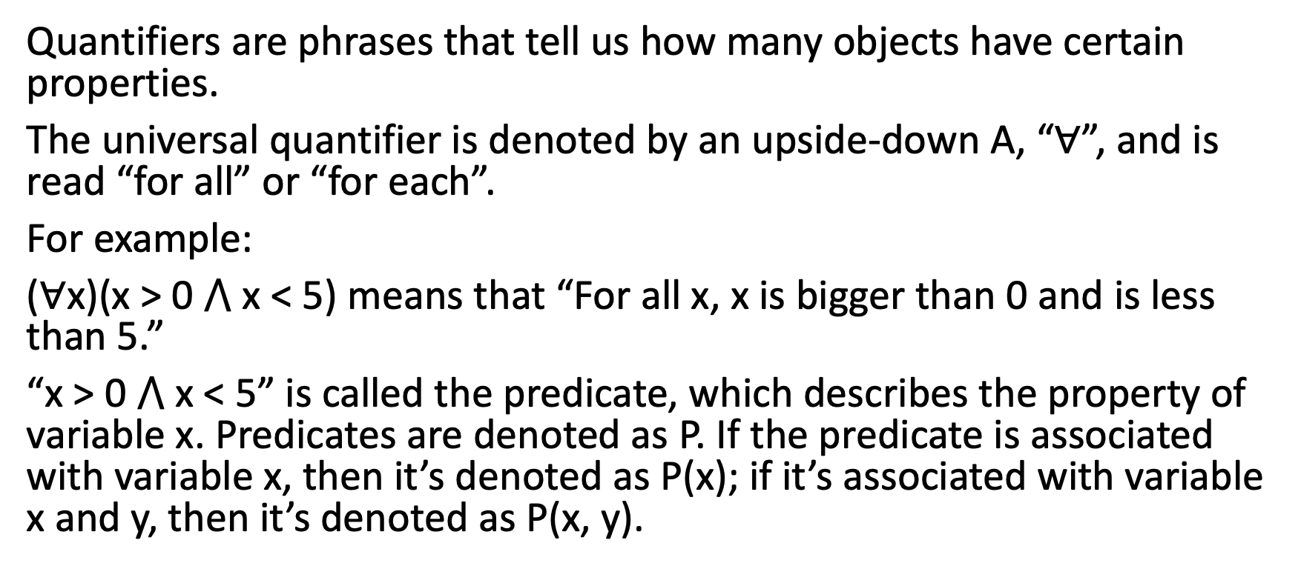
Universal Quantifier
Quantifiers are phrases that tell us how many objects have certain properties.
The universal quantifier is denoted by an upside-down A, “$∀$”, and is read “for all” or “for each”.
For example:
($∀$x)(x > 0 $⋀$ x < 5) means that “For all x, x is bigger than 0 and is less than 5.”
“x > 0 $⋀$ x < 5” is called the predicate, which describes the property of variable x. Predicates are denoted as P. If the predicate is associated with variable x, then it’s denoted as P(x); if it’s associated with variable x and y, then it’s denoted as P(x, y).

Slide 41
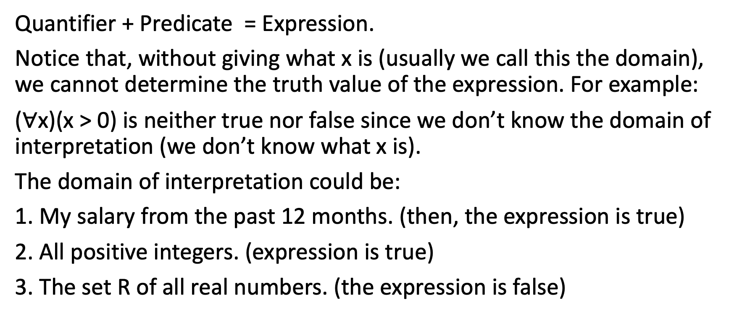
Predicate and Expression
Quantifier + Predicate = Expression.
Notice that, without giving what x is (usually we call this the domain), we cannot determine the truth value of the expression. For example:
($∀$x)(x > 0) is neither true nor false since we don’t know the domain of interpretation (we don’t know what x is).
The domain of interpretation could be:
1. My salary from the past 12 months. (then, the expression is true)
2. All positive integers. (expression is true)
3. The set R of all real numbers. (the expression is false)

Slide 42
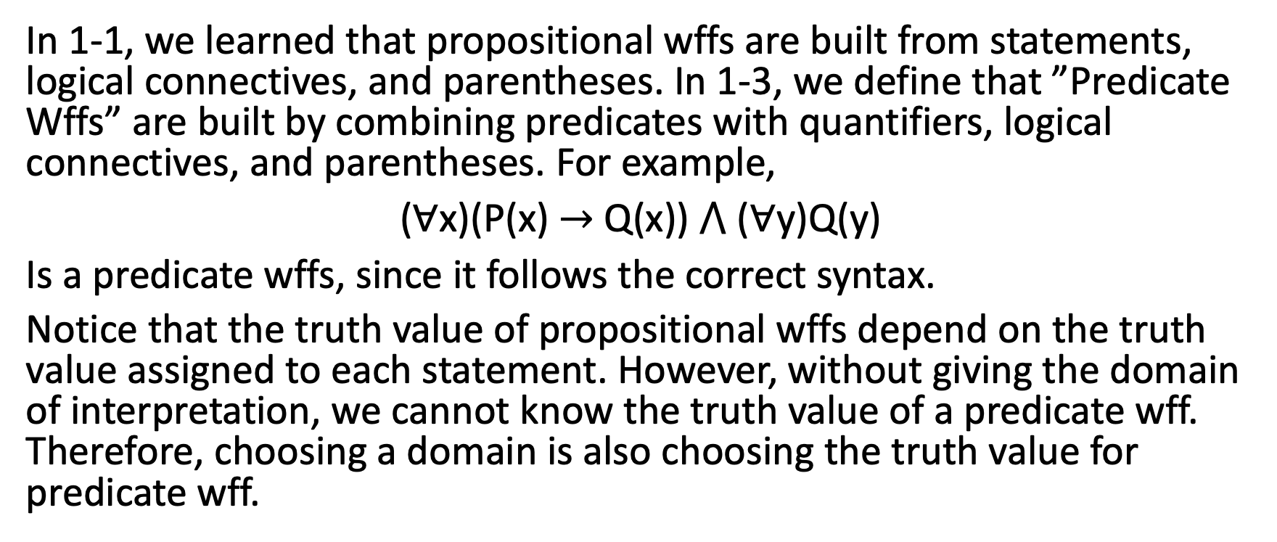
Propositional Wffs and Predicate Wffs
In 1-1, we learned that propositional wffs are built from statements, logical connectives, and parentheses. In 1-3, we define that ”Predicate Wffs” are built by combining predicates with quantifiers, logical connectives, and parentheses. For example,
($∀$x)(P(x) $→$ Q(x)) $⋀$ ($∀$y)Q(y)
Is a predicate wffs, since it follows the correct syntax.
Notice that the truth value of propositional wffs depend on the truth value assigned to each statement. However, without giving the domain of interpretation, we cannot know the truth value of a predicate wff. Therefore, choosing a domain is also choosing the truth value for predicate wff.

Slide 43
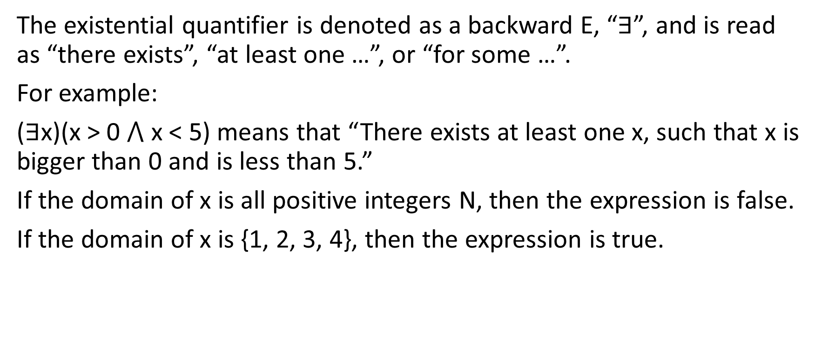
Existential Quantifier
The existential quantifier is denoted as a backward E, “$∃$”, and is read as “there exists”, “at least one …”, or “for some …”.
For example:
($∃$x)(x > 0 $⋀$ x < 5) means that “There exists at least one x, such that x is bigger than 0 and is less than 5.”
If the domain of x is all positive integers N, then the expression is false.
If the domain of x is {1, 2, 3, 4}, then the expression is true.

Slide 44
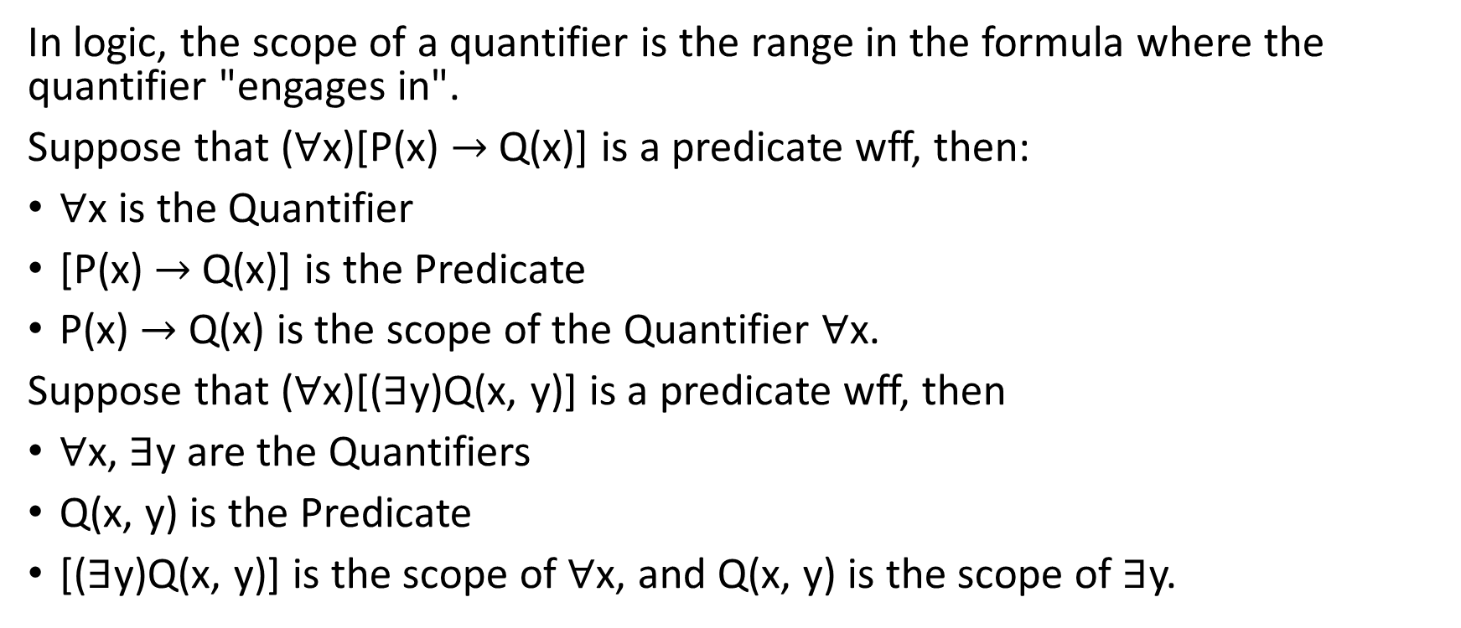
Understanding Predicate Wff
In logic, the scope of a quantifier is the range in the formula where the quantifier "engages in".
Suppose that ($∀$x)[P(x) $→$ Q(x)] is a predicate wff, then:
$∀$x is the Quantifier
[P(x) $→$ Q(x)] is the Predicate
P(x) $→$ Q(x) is the scope of the Quantifier $∀$x.
Suppose that ($∀$x)[($∃$y)Q(x, y)] is a predicate wff, then
$∀$x, $∃$y are the Quantifiers
Q(x, y) is the Predicate
[($∃$y)Q(x, y)] is the scope of $∀$x, and Q(x, y) is the scope of $∃$y.

Slide 45
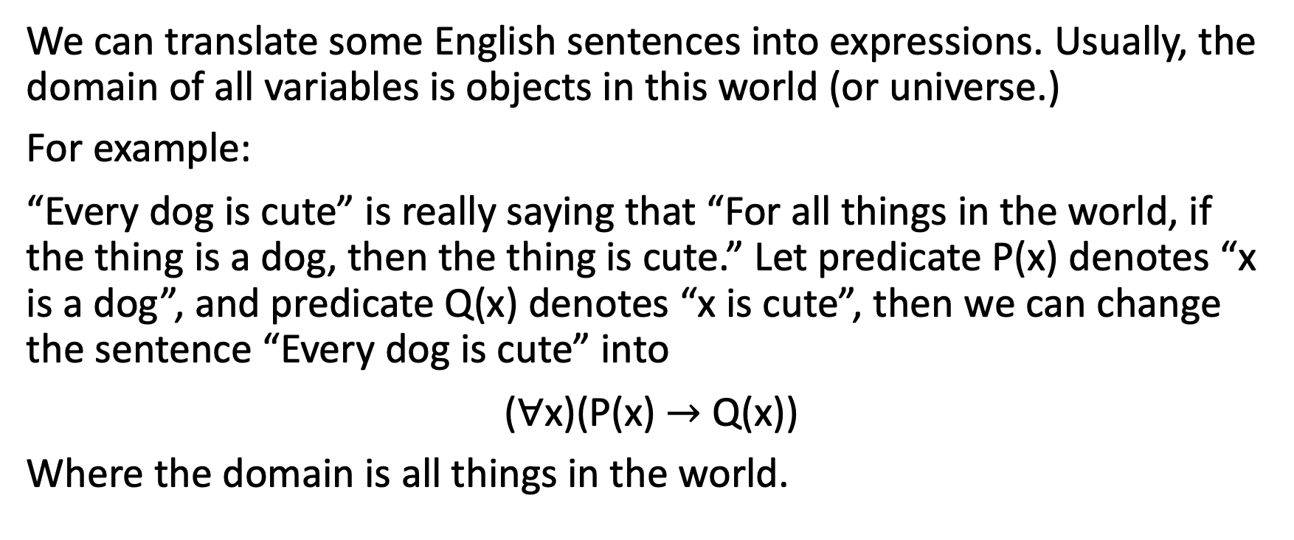
Translation
We can translate some English sentences into expressions. Usually, the domain of all variables is objects in this world (or universe.)
For example:
“Every dog is cute” is really saying that “For all things in the world, if the thing is a dog, then the thing is cute.” Let predicate P(x) denotes “x is a dog”, and predicate Q(x) denotes “x is cute”, then we can change the sentence “Every dog is cute” into
($∀$x)(P(x) $→$ Q(x))
Where the domain is all things in the world.

Slide 46
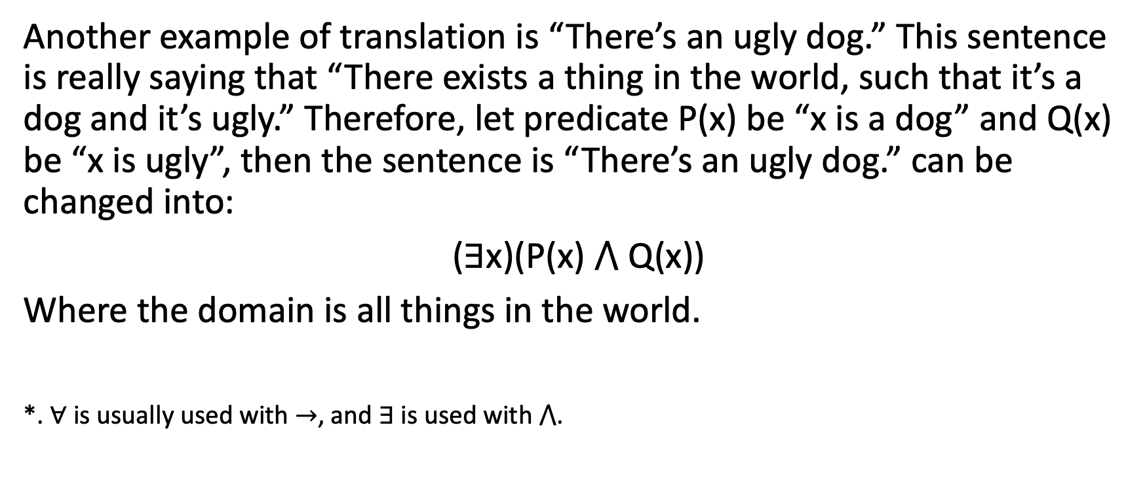
Translation
Another example of translation is “There’s an ugly dog.” This sentence is really saying that “There exists a thing in the world, such that it’s a dog and it’s ugly.” Therefore, let predicate P(x) be “x is a dog” and Q(x) be “x is ugly”, then the sentence is “There’s an ugly dog.” can be changed into:
($∃$x)(P(x) $⋀$ Q(x))
Where the domain is all things in the world.
*. $∀$ is usually used with $→$, and $∃$ is used with $⋀$.

Slide 47
Example 1-3-1
Let J(x) predicate means “x is John”, M(x) means “x is Mary”, and L(x, y) means that “x loves y”. Then, translate the sentence “John loves only Mary.”
(This means that, if there’s something in the world that John loves, then that thing must be Mary.)

Slide 48
Example 1-3-2
Let J(x) predicate means “x is John”, M(x) means “x is Mary”, and L(x, y) means that “x loves y”. Then, translate the sentence “Only John loves Mary.”
(This means, for anything in the world, if someone loves Mary, then that person must be John.)

Slide 49
Example 1-3-3
Let predicate D(x) means “x is a dog”, R(x) means “x is a rabbit”, and C(x, y) means “x chases y”. Then, translate the sentence “All dogs chase all rabbits.”
(This means that, for all things in the world, if the thing is a dog, then for any other things, if that thing is a rabbit, then the thing chases that thing.)

Slide 50
Example 1-3-4
Let predicate D(x) means “x is a dog”, R(x) means “x is a rabbit”, and C(x, y) means “x chases y”. Then, translate the sentence “Some dogs chase all rabbits.”
(This means that, there exist some dogs, we call it the thing, and for any other things, if that thing is a rabbit, then the thing chases that thing.)
(Or, this means there exists a dog that chase all rabbits)

Slide 51
Example 1-3-5
Let predicate D(x) means “x is a dog”, R(x) means “x is a rabbit”, and C(x, y) means “x chases y”. Then, translate the sentence “Only dogs chase rabbits.”
(This means that, for anything in the world, if it’s a rabbit, let’s call it the thing, then for any other thing, if that thing chases the thing, then that thing must a dog.)
(Or, if something is chasing rabbits, then that must be a dog.)

Slide 52
Practice
Using predicate F(x) means “x is a fruit”, V(x) means “x is vegetable”, and S(x, y) means “x is sweeter than y”, express the following statements:
Some vegetable is sweeter than all fruits.
Every fruit is sweeter than all vegetables.
Only fruits are sweeter than vegetables.

Slide 53
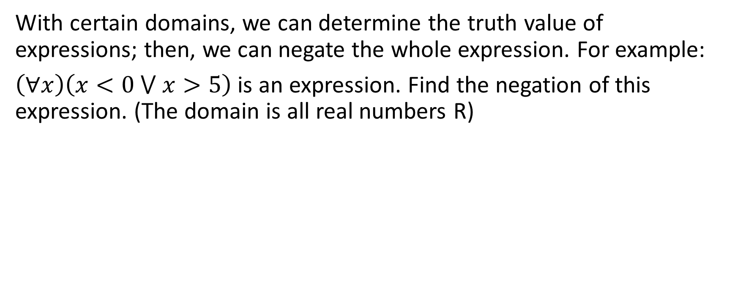
(Bonus Section) Negation of Expression
With certain domains, we can determine the truth value of expressions; then, we can negate the whole expression. For example:
$\left(∀x\right)\left(x<0 ⋁ x>5\right)$ is an expression. Find the negation of this expression. (The domain is all real numbers R)

Slide 54
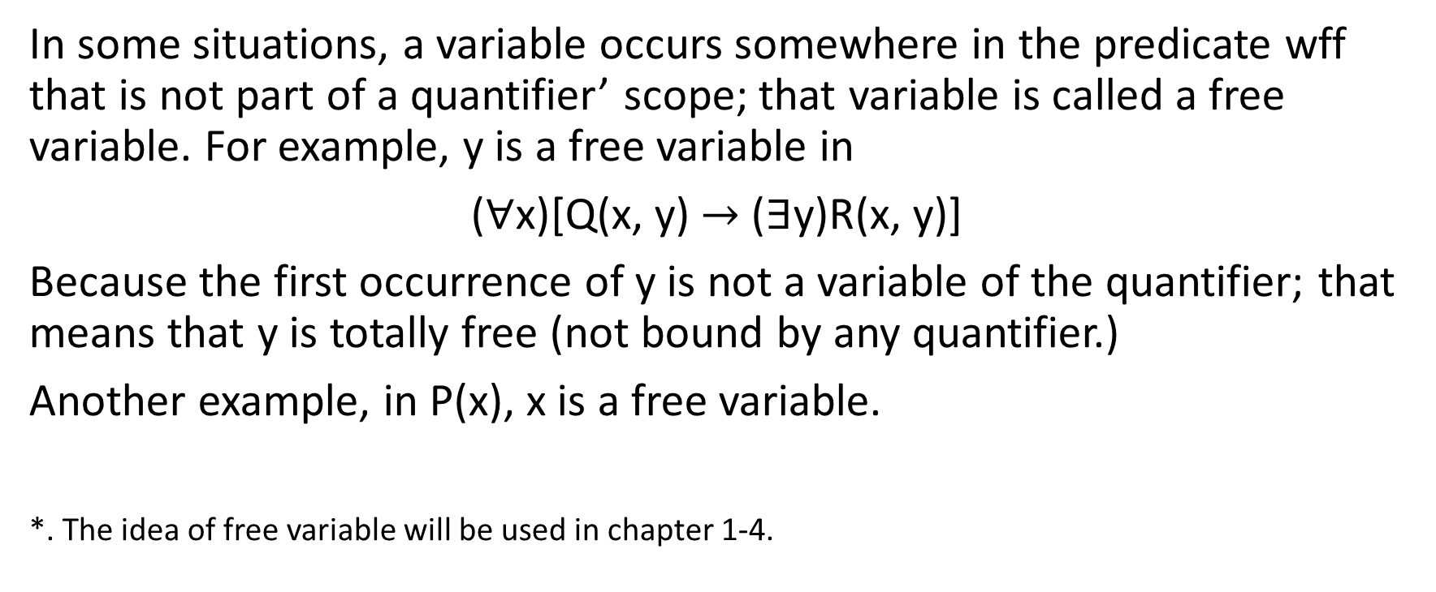
Free Variable
In some situations, a variable occurs somewhere in the predicate wff that is not part of a quantifier’ scope; that variable is called a free variable. For example, y is a free variable in
($∀$x)[Q(x, y) $→$ ($∃$y)R(x, y)]
Because the first occurrence of y is not a variable of the quantifier; that means that y is totally free (not bound by any quantifier.)
Another example, in P(x), x is a free variable.
*. The idea of free variable will be used in chapter 1-4.

Slide 55

1-4 Predicate Logic

Slide 56
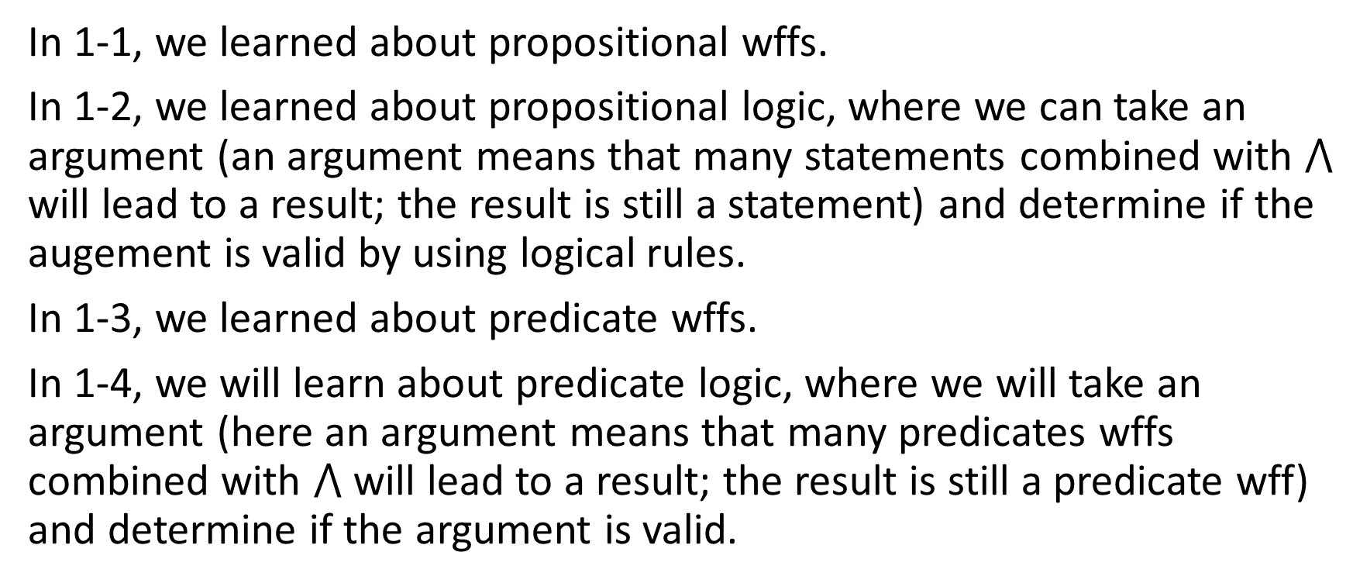
Introduction to Predicate Logic
In 1-1, we learned about propositional wffs.
In 1-2, we learned about propositional logic, where we can take an argument (an argument means that many statements combined with $⋀$ will lead to a result; the result is still a statement) and determine if the augement is valid by using logical rules.
In 1-3, we learned about predicate wffs.
In 1-4, we will learn about predicate logic, where we will take an argument (here an argument means that many predicates wffs combined with $⋀$ will lead to a result; the result is still a predicate wff) and determine if the argument is valid.

Slide 57
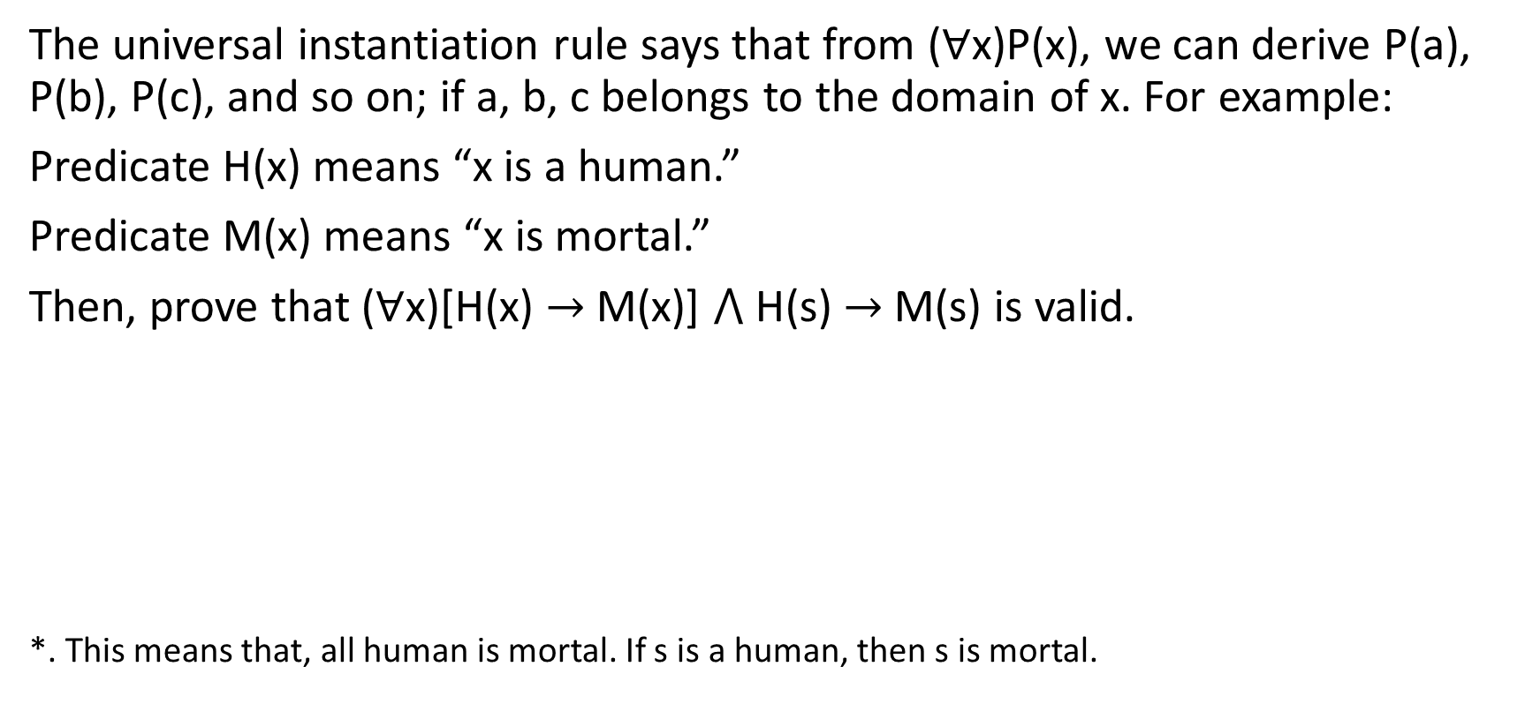
Universal Instantiation
The universal instantiation rule says that from ($∀$x)P(x), we can derive P(a), P(b), P(c), and so on; if a, b, c belongs to the domain of x. For example:
Predicate H(x) means “x is a human.”
Predicate M(x) means “x is mortal.”
Then, prove that ($∀$x)[H(x) $→$M(x)] $⋀$ H(s) $→$ M(s) is valid.
*. This means that, all human is mortal. If s is a human, then s is mortal.

Slide 58
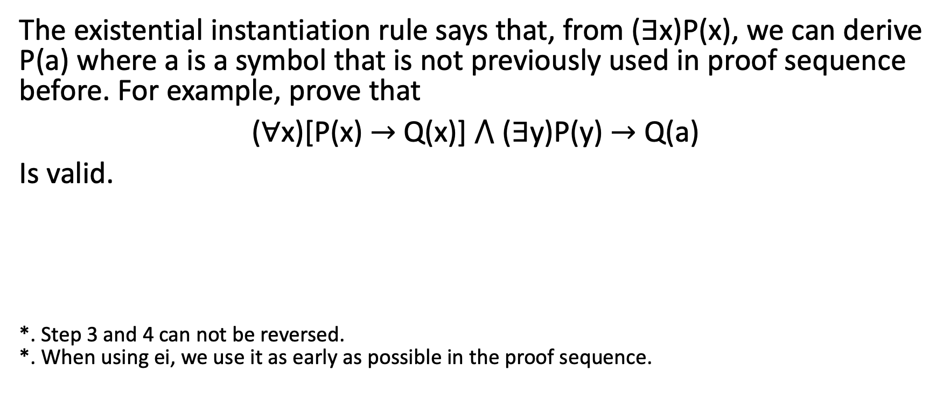
Existential Instantiation
The existential instantiation rule says that, from ($∃$x)P(x), we can derive P(a) where a is a symbol that is not previously used in proof sequence before. For example, prove that
($∀$x)[P(x) $→$ Q(x)] $⋀$ ($∃$y)P(y) $→$ Q(a)
Is valid.
*. Step 3 and 4 can not be reversed. *. When using ei, we use it as early as possible in the proof sequence.

Slide 59
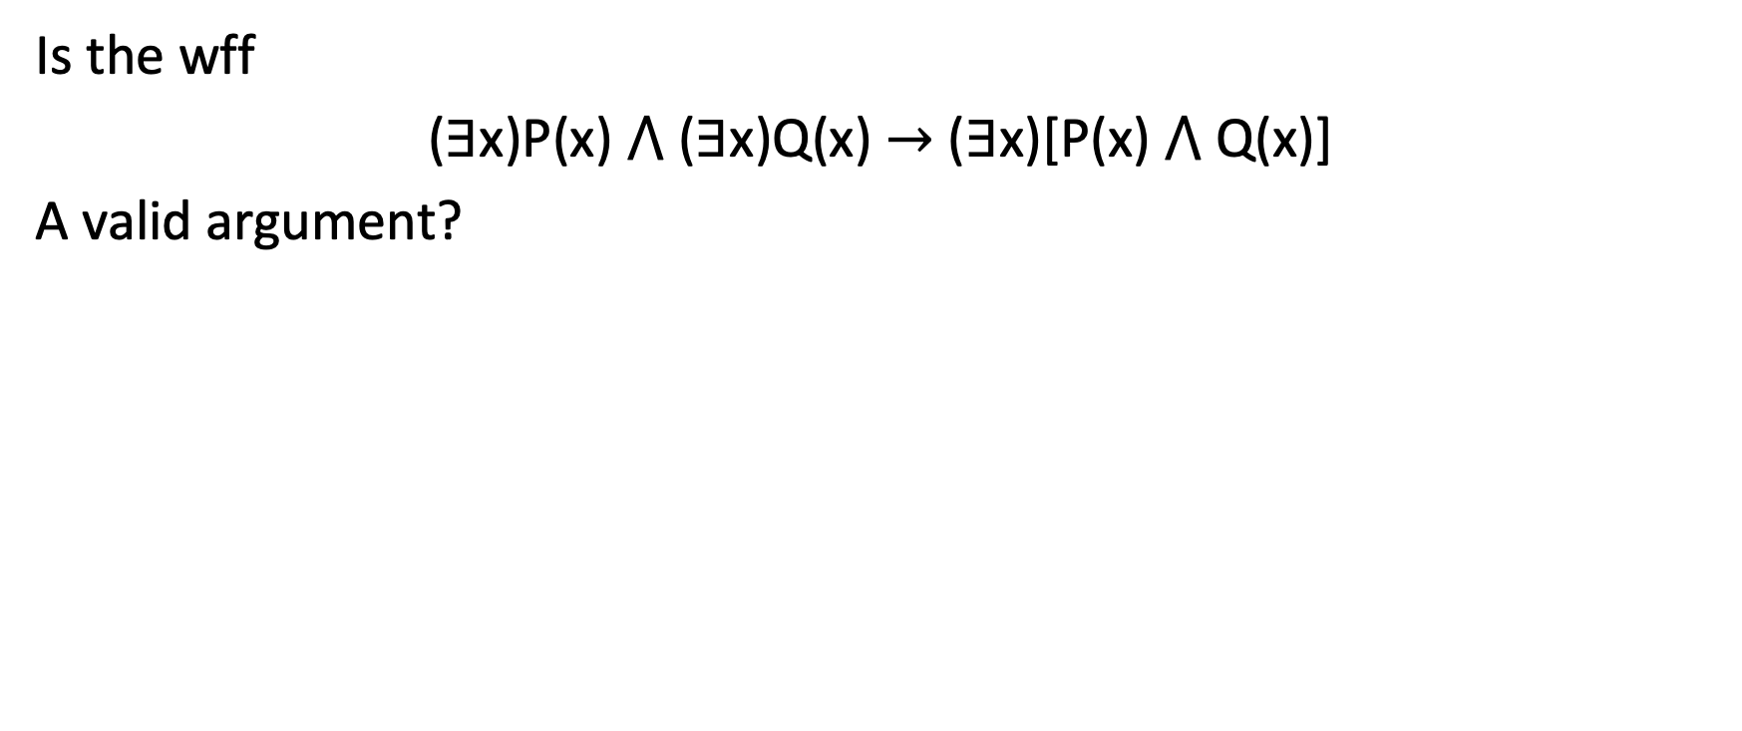
Existential Instantiation
Is the wff
($∃$x)P(x) $⋀$ ($∃$x)Q(x) $→$ ($∃$x)[P(x) $⋀$ Q(x)]
A valid argument?

Slide 60
Existential Instantiation
Using predicate logic, prove that
Some plants are flowers. All flowers smell sweet. Therefore, some plants smell sweet.
Is a valid argument.
*.ei must come before ui.

Slide 61
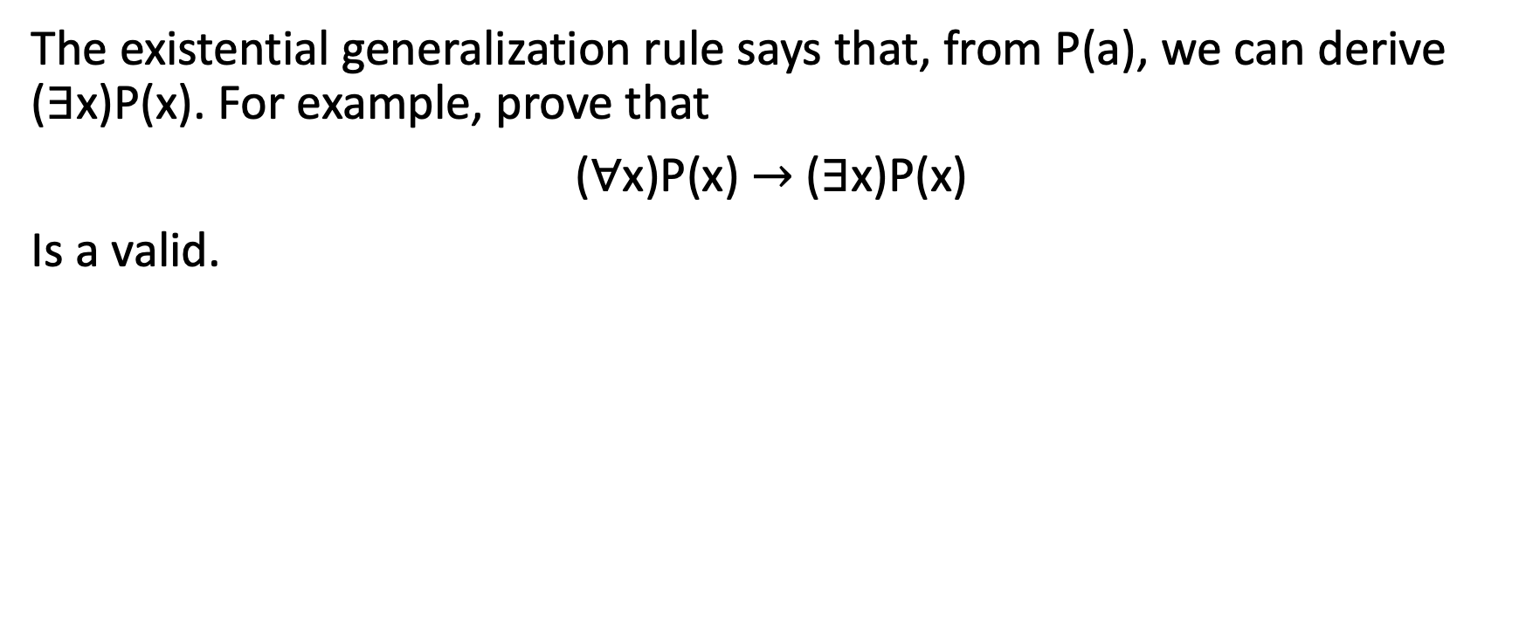
Existential Generalization
The existential generalization rule says that, from P(a), we can derive ($∃$x)P(x). For example, prove that
($∀$x)P(x) $→$ ($∃$x)P(x)
Is a valid.

Slide 62
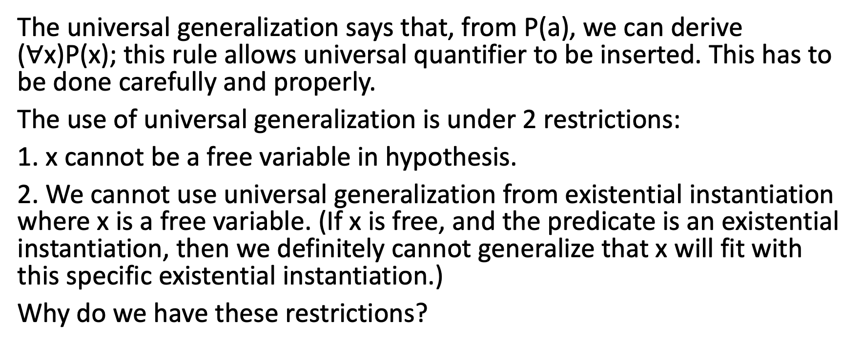
Universal Generalization
The universal generalization says that, from P(a), we can derive ($∀$x)P(x); this rule allows universal quantifier to be inserted. This has to be done carefully and properly.
The use of universal generalization is under 2 restrictions:
1. x cannot be a free variable in hypothesis.
2. We cannot use universal generalization from existential instantiation where x is a free variable. (If x is free, and the predicate is an existential instantiation, then we definitely cannot generalize that x will fit with this specific existential instantiation.)
Why do we have these restrictions?

Slide 63
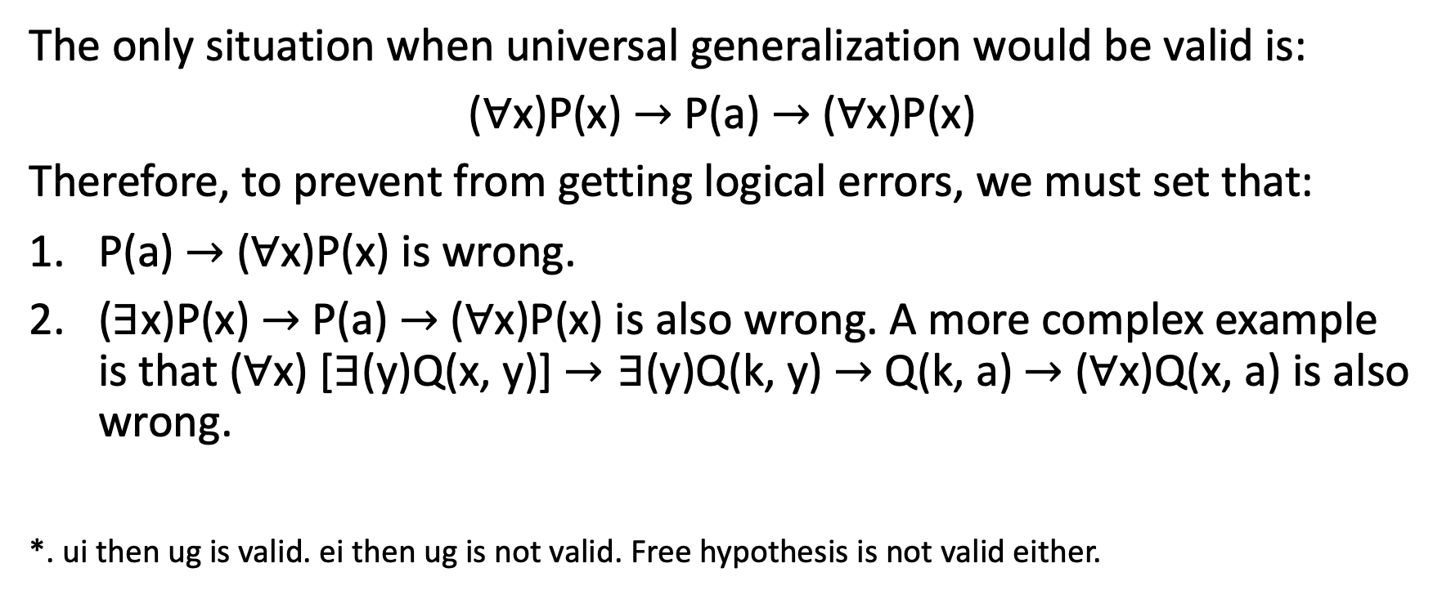
Discussion of Restrictions
The only situation when universal generalization would be valid is:
($∀$x)P(x) $→$ P(a) $→$ ($∀$x)P(x)
Therefore, to prevent from getting logical errors, we must set that:
P(a) $→$ ($∀$x)P(x) is wrong.
($∃$x)P(x) $→$ P(a) $→$ ($∀$x)P(x) is also wrong. A more complex example is that ($∀$x) [$∃$(y)Q(x, y)] $→∃\text{(}\text{y}\text{)}\text{Q}\text{(}\text{k}\text{, }\text{y}$) $→$ Q(k, a)$→$ ($∀$x)Q(x, a) is also wrong.
*. ui then ug is valid. ei then ug is not valid. Free hypothesis is not valid either.

Slide 64
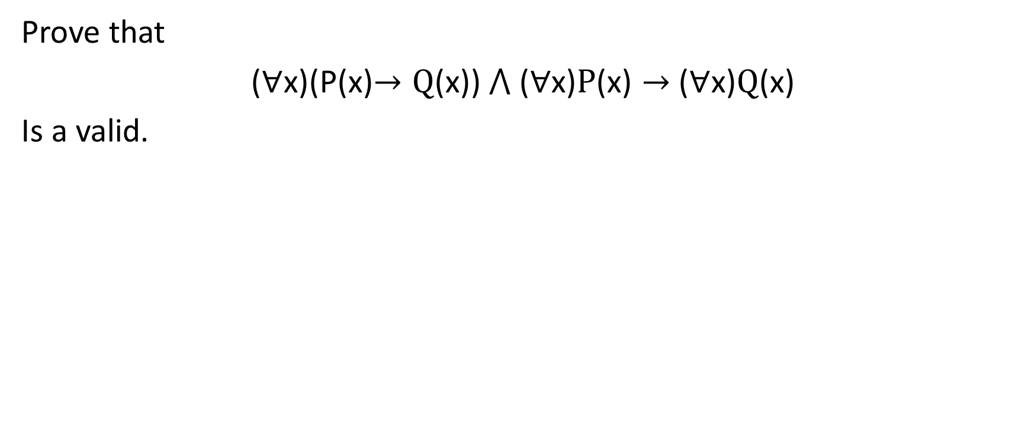
Example 1-4-1
Prove that
($∀$x)(P(x)$→Q$(x)) $⋀ \text{(}∀\text{x}\text{)}P\text{(}\text{x}\text{)}→$ ($∀$x)$Q$(x)
Is a valid.

Slide 65
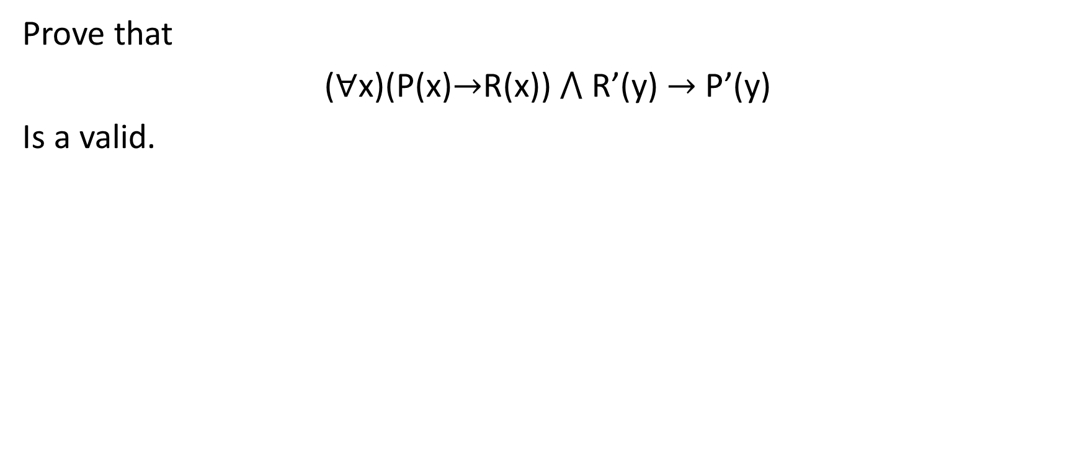
Example 1-4-2
Prove that
($∀$x)(P(x)$→$R(x)) $⋀$R’(y) $→$ P’(y)
Is a valid.

Slide 66
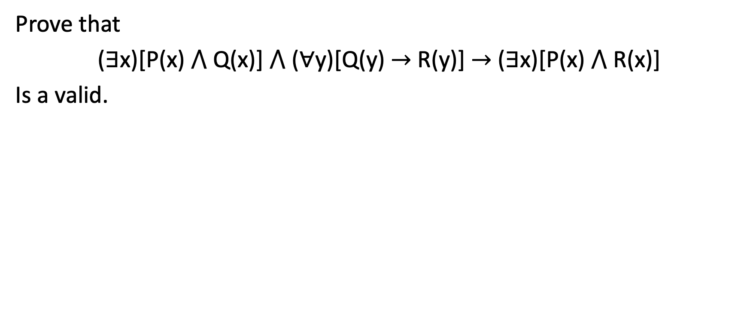
Example 1-4-3
Prove that
($∃$x)[P(x) $⋀$ Q(x)] $⋀$ ($∀$y)[Q(y) $→$ R(y)] $→$ ($∃$x)[P(x) $⋀$ R(x)]
Is a valid.

Slide 67
Practice
All the computers in the world supports USB Type-A port, some devices in the world supports both Type-A and Type-C port, therefore, some computers in the world support both Type-A and Type-C.

Slide 68

Practice
C(x) means x is a computer.
U(x) means x supports Type-A.
T(x) means x supports Type-C.
Proof that
($∀$x)[C(x) $→$ U(x)] $⋀$ ($∃$x)[C(x) $⋀$ T(x)] $→$ ($∃$x)[C(x) $⋀$ T(x) $⋀$U(x)]
is valid.

